Slide 1
The
Entrepreneurial
Arch
A Strategic Framework for Discovering, Developing and Renewing Firms
Timothy L. Faley Ph.D., MBA
Kiril Sokoloff Distinguished Professor of Entrepreneurship
Special Assistant to the President for Entrepreneurial Initiatives
University of the Virgin Islands

Slide 2
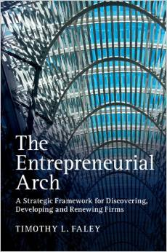
Cambridge Press, 2014
Available at:
www.entrepreneurialarch.com

Slide 3
We need more entrepreneurs….
People that can:
Identify emerging opportunities (and threats)
Formulate innovative business solutions around those opportunities
Assess the feasibility of new businesses
Develop actionable plans from disparate and incomplete information
Identify, align, and acquire the necessary resources to power the plan forward
Drive accelerated growth

Slide 4
But…
How do you develop these entrepreneurs?
Especially when you do not currently have a vibrant entrepreneurial ecosystem?
It’s a confusing landscape out there…
… that desperately needs some clarity!

Slide 5
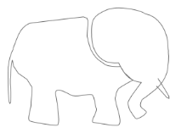
Revealing the...
Entrepreneurial Elephant
Creativity
Venture Capital
Invention
Innovation
Corporate
Renewal
Growth
Team
Building
Core Capabilities
Ideas
Lean Startup
Customer Discovery
Business
Model
Pitching
Business
Plan
Notes:
It is not that any of the parts are wrong or un-important; they just don’t tell the whole story.

Slide 6
Building a Business is a Process:: Stochastic, iterative one, but still a process
Operationalize Business
Resource /
Due Diligence
Manage Growth
Capabilities
Business
Copyright © 2012 by Timothy L. Faley

Slide 7
Building a Business is a Process:: Stochastic, iterative one, but still a process
Business Discover
Operationalize Business
Business Execution
Resource /
Due Diligence
?
Manage Growth
Capabilities
Business
Skills/Talents
Assets (physical/Intellectual)
Networks/Relationships
Interests/Passions/Aspirations
Copyright © 2012 by Timothy L. Faley
Notes:
Entrepreneurship courses typically start with business planning or other similar courses aimed at assisting the entrepreneur in operationalizing their business. However most entrepreneurs start with a set of capabilities – things they love doing – that they would like to earn a living from. What is missing is the business discovery portion of this process.

Slide 8
Building a Business is a Process:: Stochastic, iterative one, but still a process
Business
Assessment
Operationalize Business
Resource /
Due Diligence
Is it worth doing?
Manage Growth
Business
Copyright © 2012 by Timothy L. Faley
Notes:
The first step that must occur before operationalizing a business is to determine if that business is worth executing.

Slide 9
Building a Business is a Process:: Stochastic, iterative one, but still a process
Business
Assessment
Operationalize Business
Business Design
Resource /
Due Diligence
What is “it”?
Manage Growth
Business
Copyright © 2012 by Timothy L. Faley
Notes:
Before you can determine whether it is feasible, you need a clearer definition of precisely what “it” is.

Slide 10
Building a Business is a Process:: Stochastic, iterative one, but still a process
Business
Assessment
Operationalize Business
Business Design
Resource /
Due Diligence
Opportunity
Identification
Manage Growth
What problem are you solving?
Business
Copyright © 2012 by Timothy L. Faley
Notes:
The business solves a problem, satisfies a need or a desire. Before you design the business, you should know what it is trying to accomplish. That is opportunity identification.

Slide 11
Building a Business is a Process:: Stochastic, iterative one, but still a process
Business
Assessment
Operationalize Business
Business Design
Resource /
Due Diligence
The
Entrepreneurial
Arch
Opportunity
Identification
Manage Growth
Capabilities
Business
Skills/Talents
Assets (physical/Intellectual)
Networks/Relationships
Interests/Passions/Aspirations
Copyright © 2014 Timothy L. Faley
Copyright © 2012 by Timothy L. Faley
Notes:
All the left-hand side of the arch supported by the team’s or the organization’s capabilities.

Slide 12
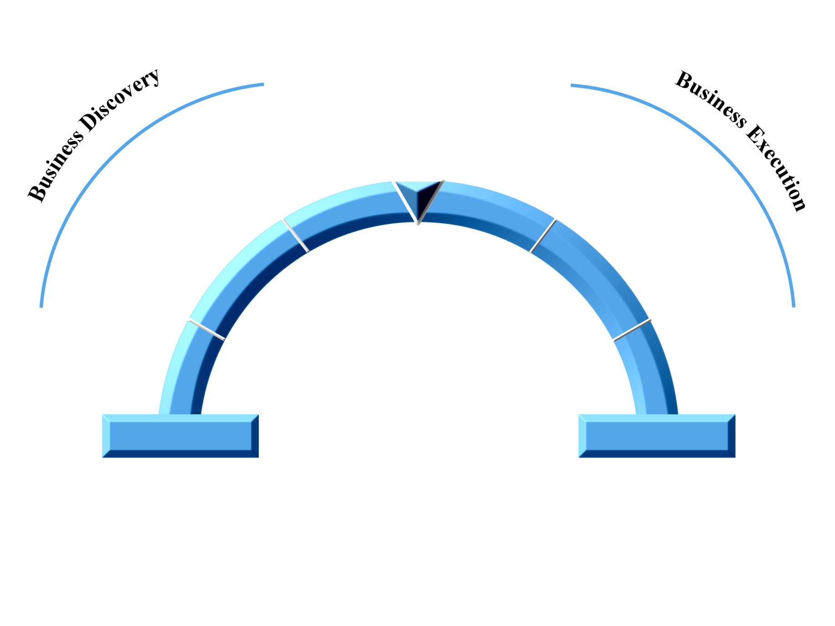
Two halves: Discovery and Execution
Business
Assessment
Operationalize Business
Business Design
Resource /
Due Diligence
The
Entrepreneurial
Arch
Opportunity
Identification
Manage Growth
Capabilities
Business
Skills/Talents
Assets (physical/Intellectual)
Networks/Relationships
Interests/Passions/Aspirations
Copyright © 2012 by Timothy L. Faley

Slide 13
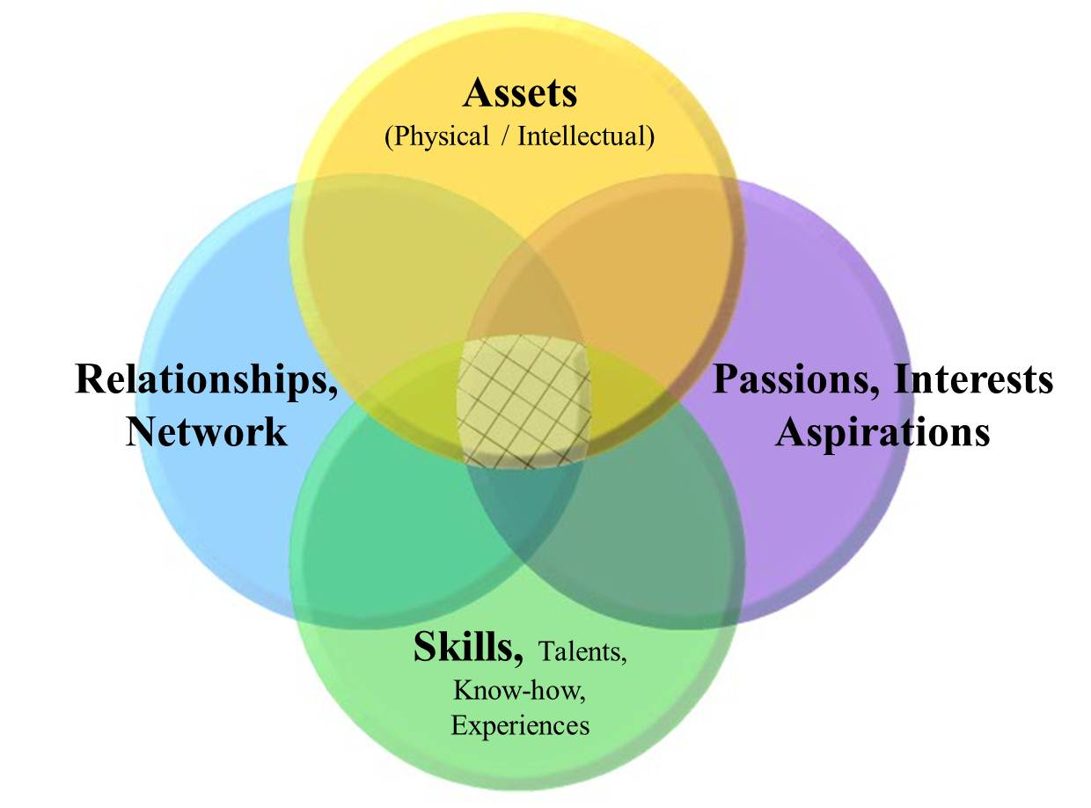
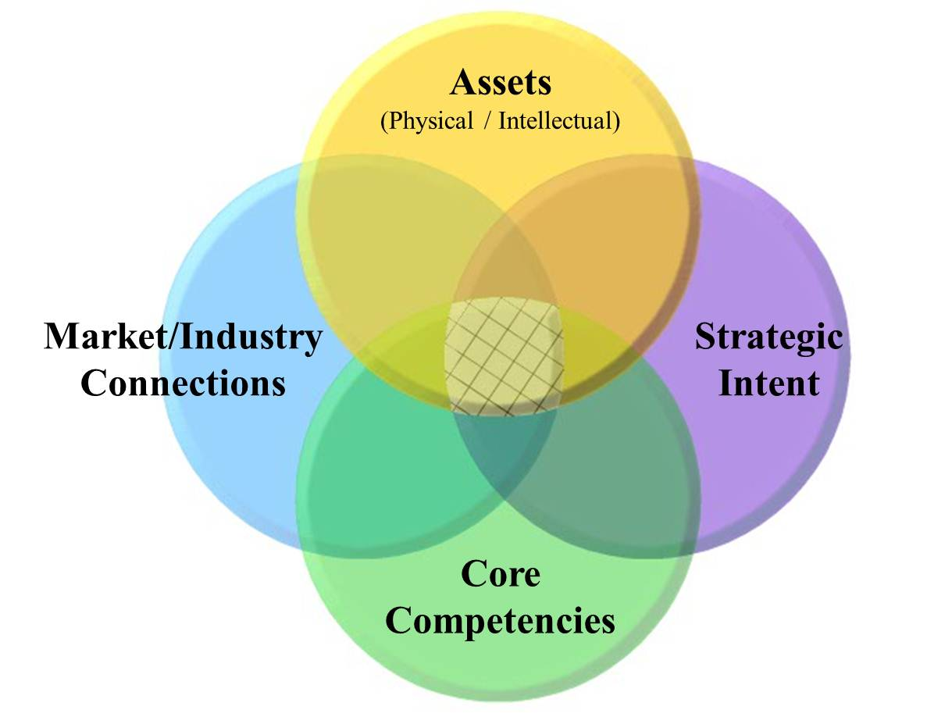
Capability Map: Foundation of Discovery
Team Capability Map
Corporate Capability Map
Notes:
“Capabilities” is used very specifically in the context of the Entrepreneurial arch. They include both ‘soft skills’ (horizontal bubbles) and ‘hard skills’ (vertical bubbles).

Slide 14
First Stages are very iterative
It is a hypothesis-directed discovery/learning process
What you learn in a subsequent stage changes your position in the prior
Move quickly – don’t fall in love with your first idea
Requires constant “zooming-in and zooming-out”
Taking both a narrow, detailed view and broad, “big picture” perspective
Business
Assessment
Operationalize Business
Business Design
Resource /
Due Diligence
The
ENTREPRENEURIAL
ARCH
Opportunity
Identification
Manage Growth
Capabilities
Business

Slide 15
Typical Business
Deliver Product and/or Service
My Company
My Customer
Capture Value
From offering
Notes:
Capture enough value to ensure the continuous operation of the enterprise

Slide 16
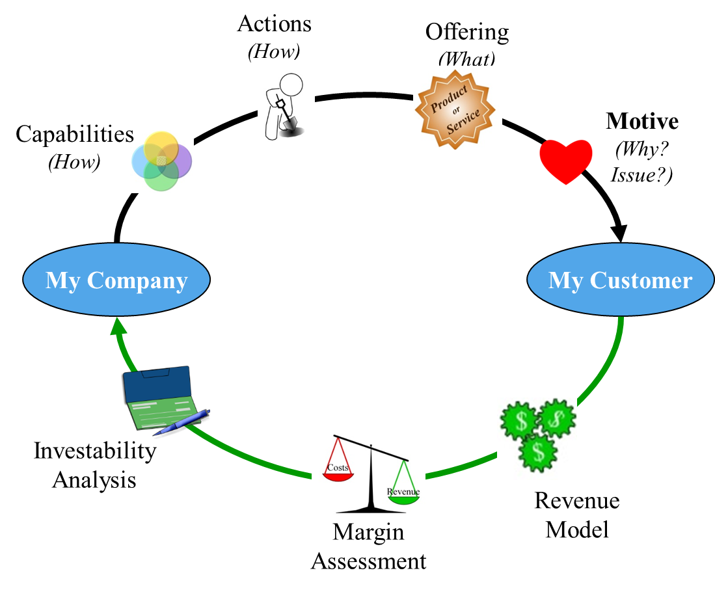
Zoom In slightly for a closer look
Activities
Customer is the
“Owner”
of the issue
your offering
solves
Monetization

Slide 17
Generalizing: 4 Pillars for Every Business
What can you do about it?
(Activity)
Can you make money doing this?
(Monetization)
What problem are you trying to solve?
(Motivation to change)
Who has this issue?
(Owner)

Slide 18
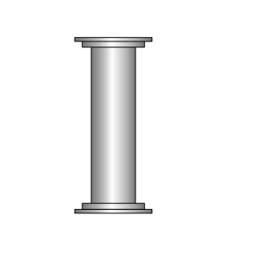
Zooming in on one of the Pillars
Who has the issue?
(Issue “Owner”)

Slide 19
Zoom in on issue “Owner” pillar to four different levels
Society
Industry (ecosystem or network of businesses)
Industry
Segment
Customer
Notes:
At the most zoomed out level, “society” is the owner of the issue. As you zoom in, the issue typically resides in a particular industry; further zooming in will narrow the issue to a particular industry segment, than ultimately to a specific customer.

Slide 20
Every Business: 4 Components
Each Business Component can be zoomed in
to 4 different levels by increasingly narrowing the field of view
to reveal the specific elements at that level
Owner (who)
Society
Industry
Industry segment
Customer
Motive (why)
Macro Driver
General Problem
Specific Issue
Need/Desire
Activity (what/how)
Opening
Capabilities
Approach
Offering/Action
Monetization
Potential to create value
Create value
H. Value / Capture value
Revenue model
Margin Assessment
Investability Analysis
Zooming In/Out
Notes:
Looking at the four levels of zooming in for all four components of a business is captured in this table. At the most zoomed in level there is a customer with a specific need/desire, a specific offering that is created by specific actions to address the customer’s need/desire. The monetization component has three elements at this most zoomed in level: Revenue model, product margin assessment and an investability analysis.

Slide 21
Moving Across the Arch’s Discovery Section…
…Means Zooming In on the Components
Business
Assessment
Business Design
Opportunity
Identification
Capabilities
Owner (who)
Motive (why)
Activity (what/how)
Monetization
Zooming In/Out

Slide 22
Business Discovery
Opening
7 Sources of Innovation
Potential for you to create value
Opening and alignment with your capabilities
High-value problem (Problem worth solving)
Industry Analysis; Value System Assessment
Potential to capture value
Strategy, Industry Analysis, Porter’s 5 Forces, Position for Value Capture (PVC)
Investable
Will it be worth more than it costs to build?

Slide 23
Macro drivers that create openings: Drucker’s 7 Sources on Innovation
Unexpected Occurrences
Believed the drug would reduce blood pressure, and it grew hair!
Incongruities
“Health care” is really about disease mitigation
Process Needs
Industry and Market Changes
Internet businesses changing the traditional retail landscape
Demographic Changes
Aging Baby Boomers are driving many healthcare/product changes
Changes in Perception
Attitude shifts, such as earth’s resources may not be infinite, influencing the “green” products revolution
New Knowledge
New technology enable new products (iPad)
Ref. Innovation and Entrepreneurship, Peter Drucker, 1985.

Slide 24
Business Discovery
Opening
7 Sources of Innovation
Potential for you to create value
Opening and alignment with your capabilities
High-value problem (Problem worth solving)
Industry Analysis; Value System Assessment
Potential to capture value
Strategy, Industry Analysis, Porter’s 5 Forces, Positioning for Value Capture (PVC)
Investable
Will it be worth more than it costs to build? (Assessment)

Slide 25
At the end of Opportunity Identification
What’s the problem?
Know the issue (not the specific customer need, but the higher-level issue)
Who owns the problem?
What industry segment is struggling with this (again not all the way to customer yet, but a higher intermediate level)
What is your approach to solving this problem
Not a specific solution yet, but an approach
Can you create and capture value?
Approach align with your Capabilities?
If successful are you in a position to capture the created value?

Slide 26
Five generic approaches to Value Creation: Creating Value in an Existing System
New product entry
essentially a “me too” product/service to those that exist, but with some advantage
Substitute product (different solution for same need)
Better, faster, cheaper, more convenient than existing product/service
Aggregation/Consolidation of a segment of the value chain
Collapsing multiple segments of the value chain
New Segment
Creating efficiencies between existing segments

Slide 27
PVC: Positioning for Value Capture
Complementary Capabilities
(Things you need beyond your current Capabilities
to create and deliver your product to your customer)
Increasingly difficult to appropriate
Specialized
Generic
Unclear value
capture structure:
Narrow Business
or
Partner with
and/or License to
CC holder
Strong
High-growth
New Business
Potential
Specialized
Your current Capabilities
Increasingly difficult to replicate
Capabilities have
no capturable
value
Niche
Business
Potential
Generic
Ref: Based on David Teece’s framework, 1986
Notes:
Knowing you can create value is not enough. You need to be able to capture a portion of that created value. Determining that requires an industry-level view, not simply a customer view, as all of the industry in which you reside will want some of the created value. The PVC provides a company’s prospect for capturing value it creates.

Slide 28
Opportunity Identification Level of the 4 Components
Owner (who)
Society
Industry
Industry segment
Customer
Motive (why)
Macro Driver
General Problem
Specific Issue
Need/Desire
Activity (what/how)
Opening
Capabilities
Approach
Offering/Action
Monetization
Potential to create value
Create value
H. Value / Capture value
Revenue model
Margin Assessment
Investability Analysis
Zooming In/Out
End of Opportunity Identification
Notes:
At the end of opportunity identification, you have not yet zoomed into to a specific customer or a specific solution; but rather to a issue and an approach to solving that issue.

Slide 29
Business Design
Drill down on the identified opportunity
Qualitatively define the business
Notes:
Zooming down to the final view is done in two steps… a QUALitative look, followed by a QUANTitative examination.

Slide 30
Business Design Output: Crafting a High-level Business Framework
Business Construct
Activities
Offering:
What precisely is your product/service?
Actions:
What precisely does the company do?
How does this leverage your Capabilities?
What activities do you leverage from the existing ecosystem?
Owner
Who are your customers and collaborators?
What is your target persona? (Need-based market segment?)
Motive
Why do your customers/collaborators buy your product / collaborate with you?
What value do you create/problem do you solve for the your customer and collaborator?
How does your offering compare to existing solution?
Monetization
How does your company make money (revenue model)?
Value capture mechanism?
Notes:
The “business construct” is the qualitative view of the business model. Not quite a business model, since it does not contain the quantitative parts (margins, investment). Clearly articulating and assessing the qualitative before jumping into and assessing the quantitative helps avoid getting ‘lost in the numbers.’

Slide 31
Position Statement for Customer
Clearly articulated positioning statement
For … (target segment / persona)
The … (product / service)
Satisfies… (most important user need)
By delivering... (key benefit or feature)
Through/via/created by our… (underlying capability)
Example
For the small or home-based business owners
Symantec Endpoint Protection Small Business Edition
Prevents cybercriminals from accessing and destroying your vital business information
By protecting your computers and servers
Through seamless, user-transparent updating of your machines with the most current antivirus, anti-malware technology updates
Notes:
Clear and precise position statements can also be written at this stage. Both for customer and collaborators (see next slide)

Slide 32
Position Statement for Collaborator
Clearly articulated collaborator positioning statement
For … (collaborator)
Our … (product / service)
Effect…(what does it do for them?)
Benefit/Value… (what is the benefit or Value to them?)
By... (means of achieving benefit/value)
Example
Ultrasound manufacturer
Our image-enhancing software
Provides a differentiated scanner in a crowded marketplace
That will allow them to increase market share
By helping hospitals reduce their patient length-of-stays through improved diagnoses

Slide 33
Business Assessment
Quantify the designed business
Compete the business model
Customers (Quantified the number)
Understand their need/desire
Defined the business’ offering and the activities that the business must perform in the creation and delivery of that offering to the customer
Defined and quantified the revenue model
Quantified the offering’s cost structure
Determined the investment required to build the business and the attractiveness of that to investors
At the end of this stage, you know precisely what you plan to do, but you have not yet operationalized it (defined precisely how you are going to do it).
Notes:
Once you are satisfied that the qualitative is clear and makes sense (the PVC assessment looks good, for example), THEN you can proceed to the detailed quantitative analysis of a feasibility study.

Slide 34
Business Assessment
Is it real?
Can we win?
Is it worth doing?
Under what conditions?
Are these conditions realistic?
What are the critical factors for success of this business?

Slide 35
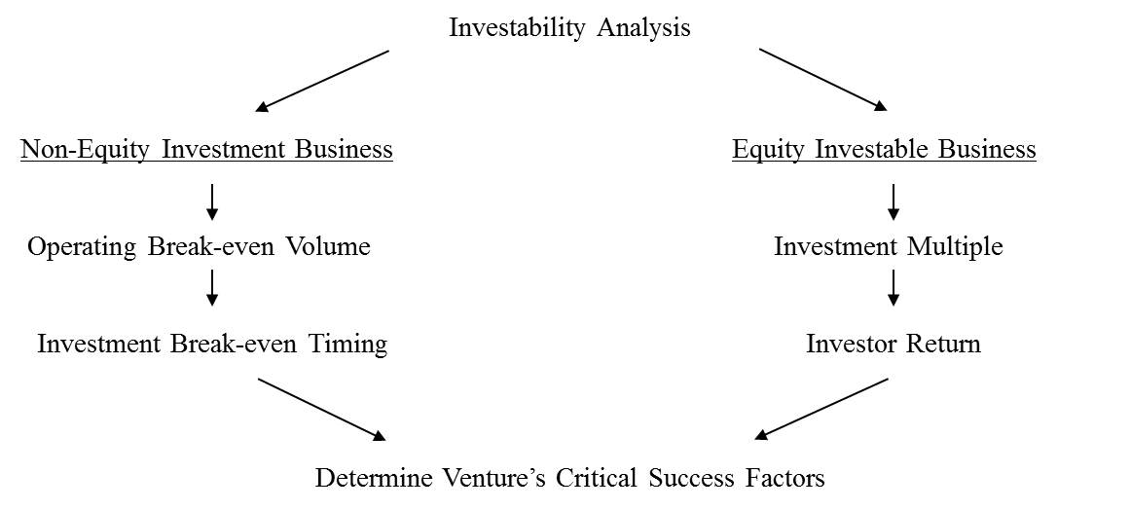
Financial Assessments depend on investment type
Investment Screen
Notes:
Different business have the potential to attract different types of capital. The financial assessment of those businesses is dependent on the type of capital that will fund the business.

Slide 36
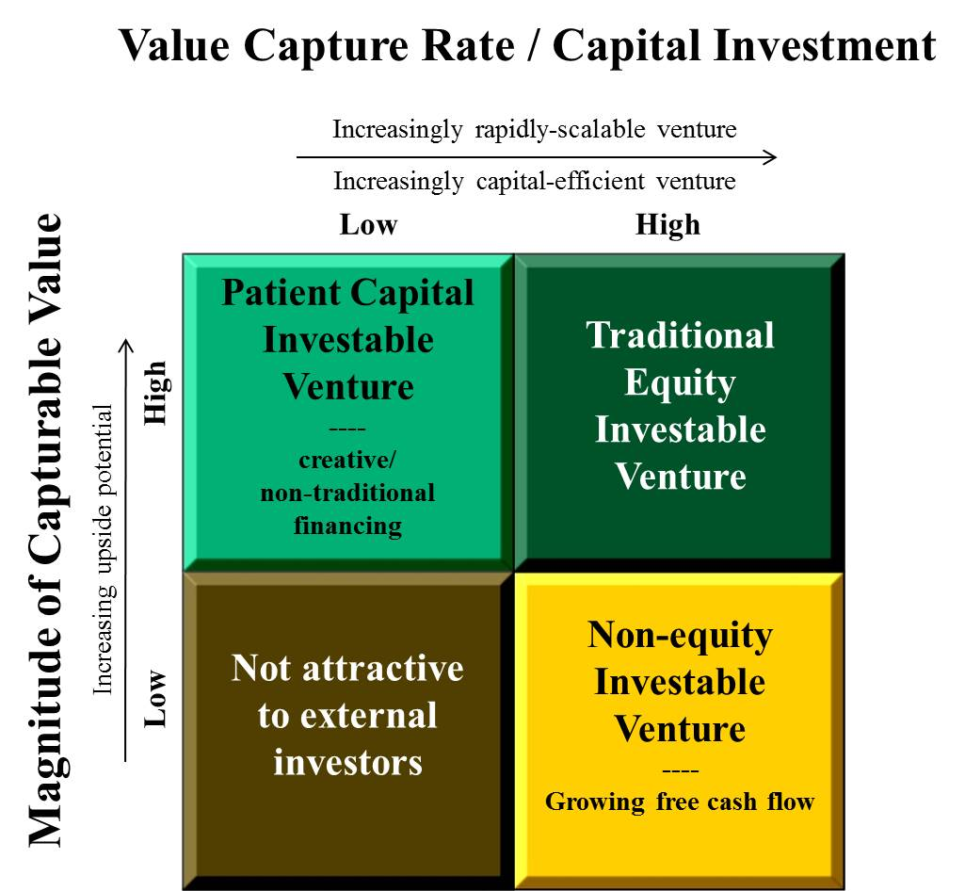
Investment Potential Framework: Determining the Investment type the new firm could attract
Notes:
This framework (commercialized as www.keystonecompact.com) indicates the type of business that the company COULD attract. It does not mean the company would desire that type of financing, it simply means they could attract that type.

Slide 37
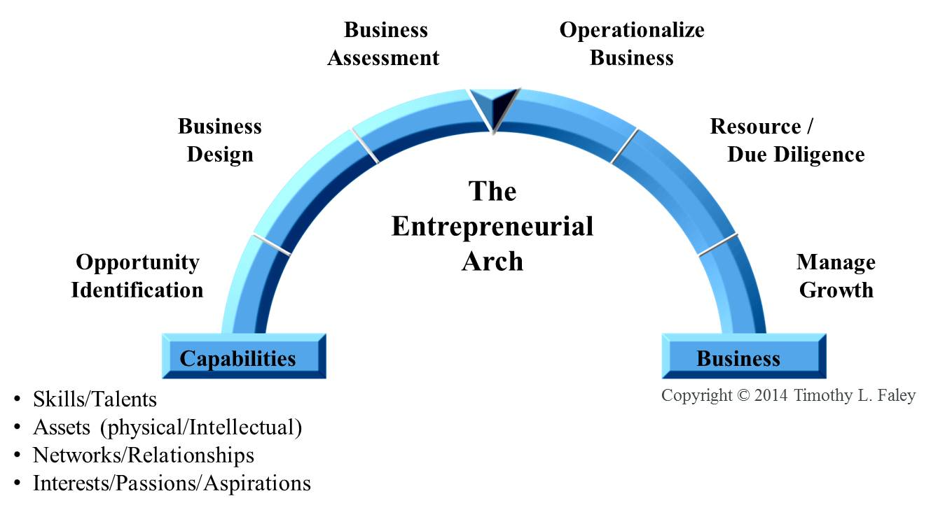
Executing Your Business
Business Execution
Plan, Launch, Grow
Notes:
Once past assessment and the feasibility study one is ready to determine how to execute the business. The business model (now complete at the end of assessment) only tells you what type of business you desire to build. It does not tell you HOW you will execute that business. The first step in that executing is the plan.

Slide 38
Operationalizing the Business
How are you going to execute the business model?
Business Model: Architectural-level view of the firm versus a strategic or operational one⁽¹⁾
Business Plan: Operating Document
Articulates methods for mitigating the risks
(1) Ref: Evolution of the Business Model, CH Leung, http://alexandria.tue.nl/extra1/afstversl/tm/leung2007.pdf

Slide 39
Resourcing the Business
Financial Capital
Plan and timing for acquiring
Human Capital
Plan and timing for acquiring
Expanding Capability Set

Slide 40
Managing Growth: 3 Forms to Consider
Personal
When do the needs of the business outstrip your personal skillset?
Product
How do you proliferate the product beyond the initial market segment?
Corporate
How to expand beyond your initial product?

Slide 41
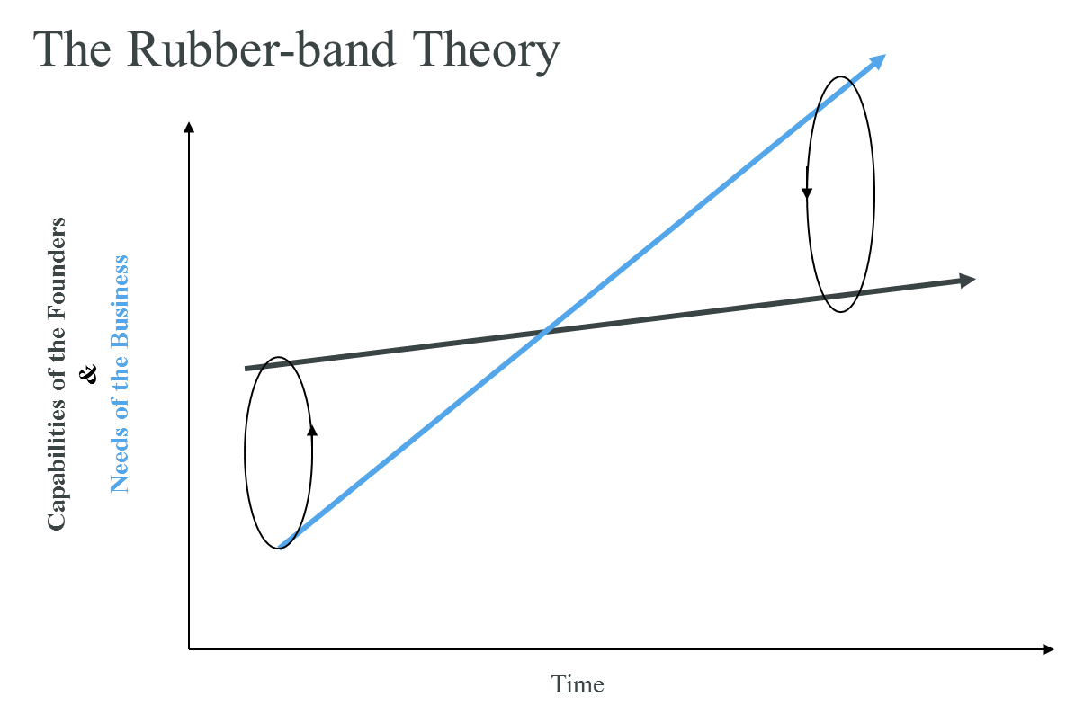
Personal: Leadership Needs Also Change with Growth
Ref: Mark Paul, “Entrepreneurs Survival Guide”

Slide 42
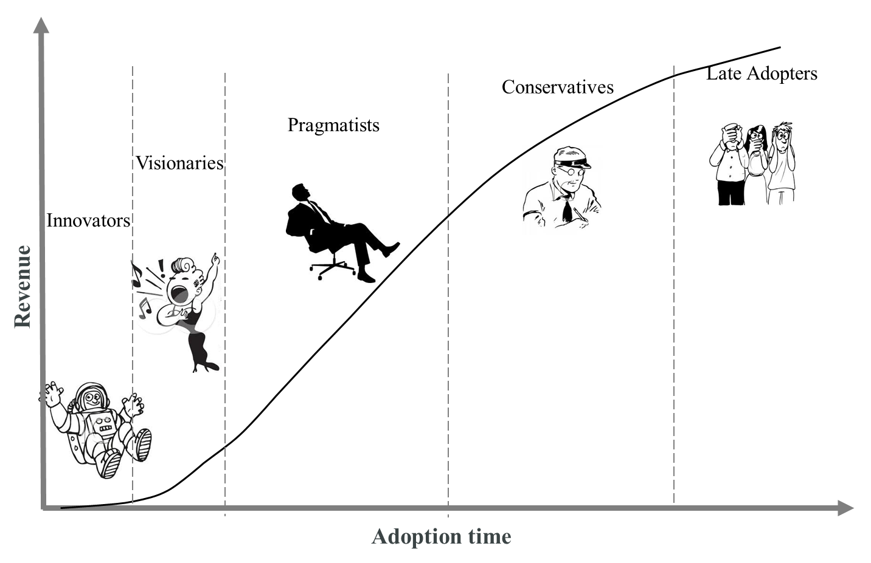
Product: Adoption Curve, will product need to change?

Slide 43
Corporate Growth: Sequencing Capability and Market Adjacencies
Sequencing Market and Capability Adjacencies
New Market, New Capabilities, or Both
Revenue
Market Adoption Curves
Time

Slide 44
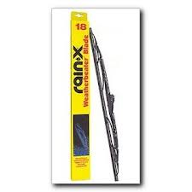
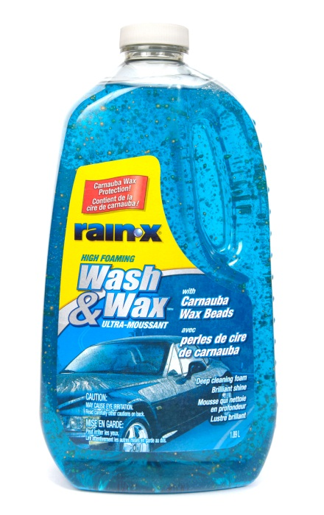
Rain-X: Market Adjacency Growth
Notes:
Rain-X moved from product to product in the same general market. They grew by moving to adjacent markets from their initial segment. They needed to leverage the capabilities they acquired along the way in each new offering.

Slide 45
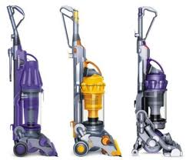
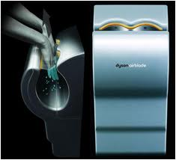
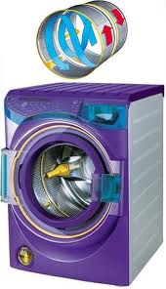
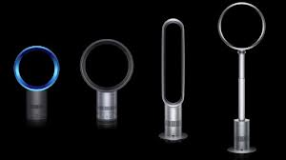
Dyson: Capability Adjacency Growth
Notes:
Capability adjacencies are much different. Dyson sticks to its core capability of air movement and elegant design. It then manifests these basic capabilities into products aimed at VERY different markets.

Slide 46
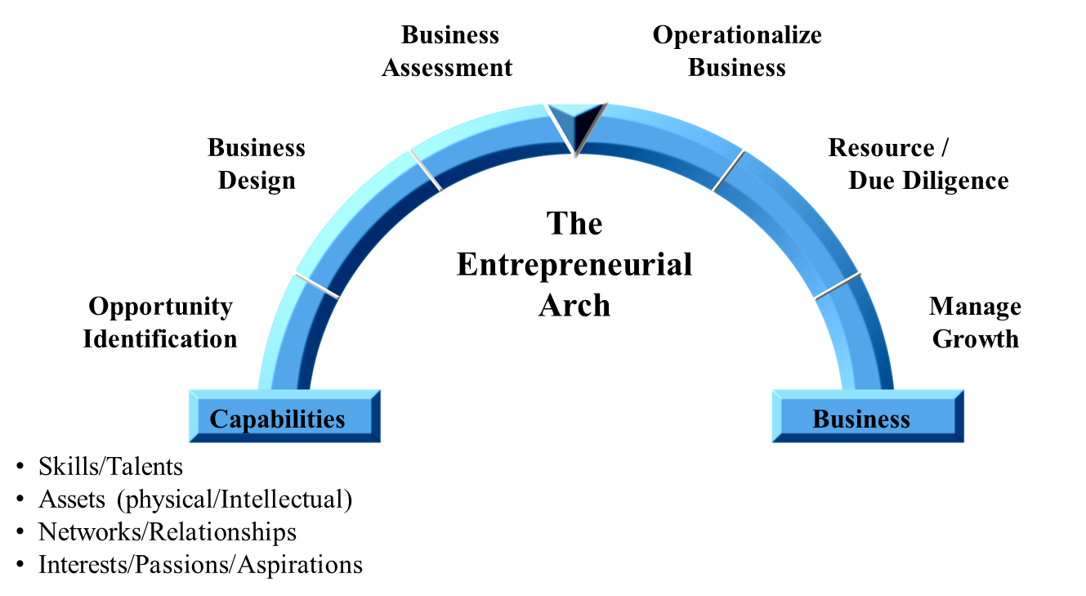
Corporate Renewal: Back to the beginning
Corporate Renewal
How to best leverage your expanded capability set?
Notes:
As a company grows and gains experience, it acquires new capabilities. During renewal, the company re-assesses its entire new capability set and starts all over at the beginning of the Arch. Renewal is similar to capability adjacency, but broader as the firm is not simply leveraging its core capabilities (as Dyson did), but all their newly acquires ones as well.

Slide 47
The Entrepreneurial Arch
www.EntrepreneurialArch.com

Slide 48
Questions?
Contact:
info@EntrepreneurialArch.com

