Slide 1
The
Entrepreneurial
Arch
A Strategic Framework for Discovering, Developing and Renewing Firms
Entrepreneurial Arch Introduction Part I
Dr. Tim Faley
Kiril Sokoloff Distinguished Professor of Entrepreneurship
Special Assistant to the President for Entrepreneurial Initiatives
University of the Virgin Islands
Tfaley@uvi.edu

Slide 2
Cambridge Press, 2014
Available at:
www.amazon.com/author/timfaley

Slide 3
We need more entrepreneurs….
People that can:
Identify emerging opportunities (and threats)
Formulate innovative business solutions around those opportunities
Assess the feasibility of new businesses
Develop actionable plans from disparate and incomplete information
Identify, align, and acquire the necessary resources to power the plan forward
Drive accelerated growth

Slide 4
But…
How do you develop these entrepreneurs?
Especially when you do not currently have a vibrant entrepreneurial ecosystem?
It’s a confusing landscape out there…
… that desperately needs some clarity!

Slide 5
Revealing the...
Entrepreneurial Elephant
Creativity
Venture Capital
Invention
Innovation
Corporate
Renewal
Growth
Team
Building
Core Capabilities
Ideas
Lean Startup
Customer Discovery
Business
Model
Pitching
Business
Plan
Notes:
It is not that any of the parts are wrong or un-important; they just don’t tell the whole story.

Slide 6
Building a Business is a Process: Stochastic, iterative one, but still a process
Business Development
Operationalize Business
Business Execution
Resource /
Due Diligence
?
Manage Growth
Capabilities
Business
Skills/Talents
Assets (physical/Intellectual)
Networks/Relationships
Interests/Passions/Aspirations
Copyright © 2012 by Timothy L. Faley
Notes:
Entrepreneurship courses typically start with business planning or other similar courses aimed at assisting the entrepreneur in operationalizing their business. However most entrepreneurs start with a set of capabilities – things they love doing – that they would like to earn a living from. What is missing is the business discovery portion of this process.

Slide 7
Building a Business is a Process:: Stochastic, iterative one, but still a process
Business
Assessment
Operationalize Business
Resource /
Due Diligence
Is it worth doing?
Manage Growth
Business
Copyright © 2012 by Timothy L. Faley
Notes:
The first step that must occur before operationalizing a business is to determine if that business is worth executing.

Slide 8
Building a Business is a Process:: Stochastic, iterative one, but still a process
Business
Assessment
Operationalize Business
Business Design
Resource /
Due Diligence
What is “it”?
Manage Growth
Business
Copyright © 2012 by Timothy L. Faley
Notes:
Before you can determine whether it is feasible, you need a clearer definition of precisely what “it” is.

Slide 9
Building a Business is a Process:: Stochastic, iterative one, but still a process
Business
Assessment
Operationalize Business
Business Design
Resource /
Due Diligence
Opportunity
Identification
Manage Growth
What problem are you solving?
Business
Copyright © 2012 by Timothy L. Faley
Notes:
The business solves a problem, satisfies a need or a desire. Before you design the business, you should know what it is trying to accomplish. That is opportunity identification.

Slide 10
Process with two halves
Business Development
Business
Assessment
Operationalize Business
Business Execution
Business Design
Resource /
Due Diligence
The
Entrepreneurial
Arch
Opportunity
Identification
Manage Growth
Capabilities
Business
Skills/Talents
Assets (physical/Intellectual)
Networks/Relationships
Interests/Passions/Aspirations
Copyright © 2014 Timothy L. Faley
Copyright © 2012 by Timothy L. Faley
Notes:
All the left-hand side of the arch supported by the team’s or the organization’s capabilities.

Slide 11
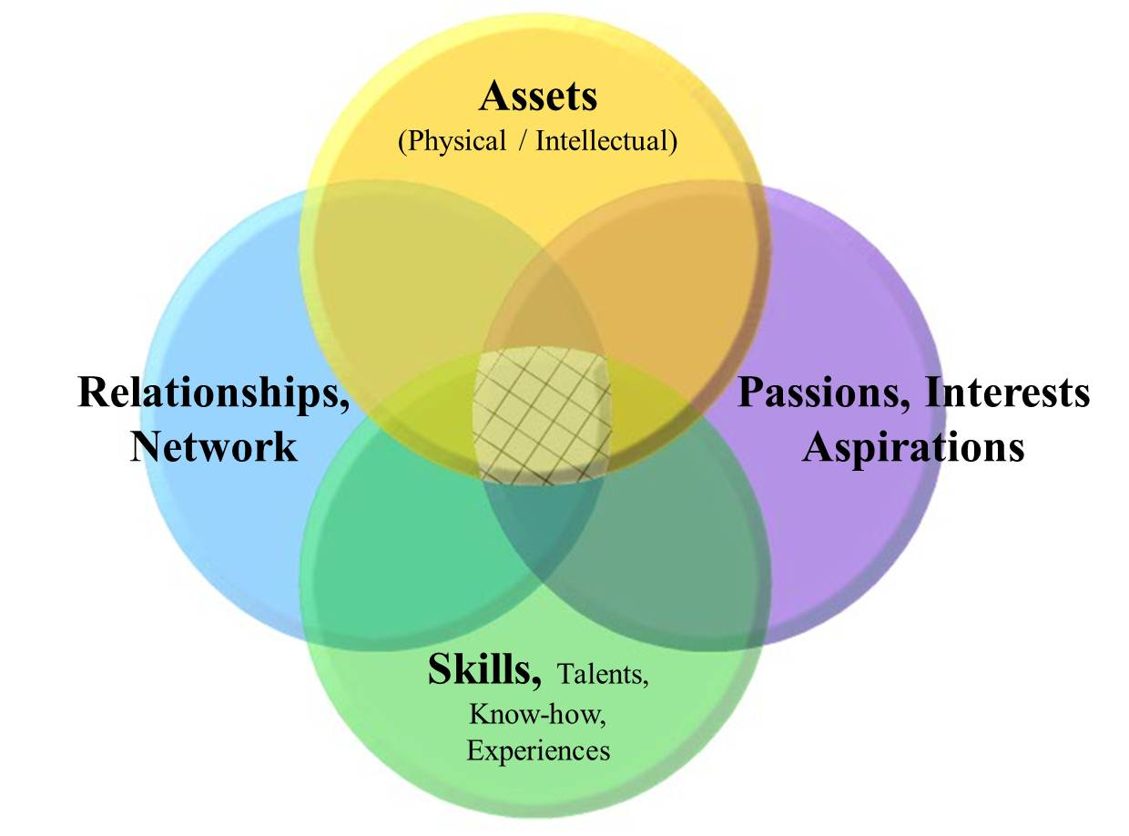
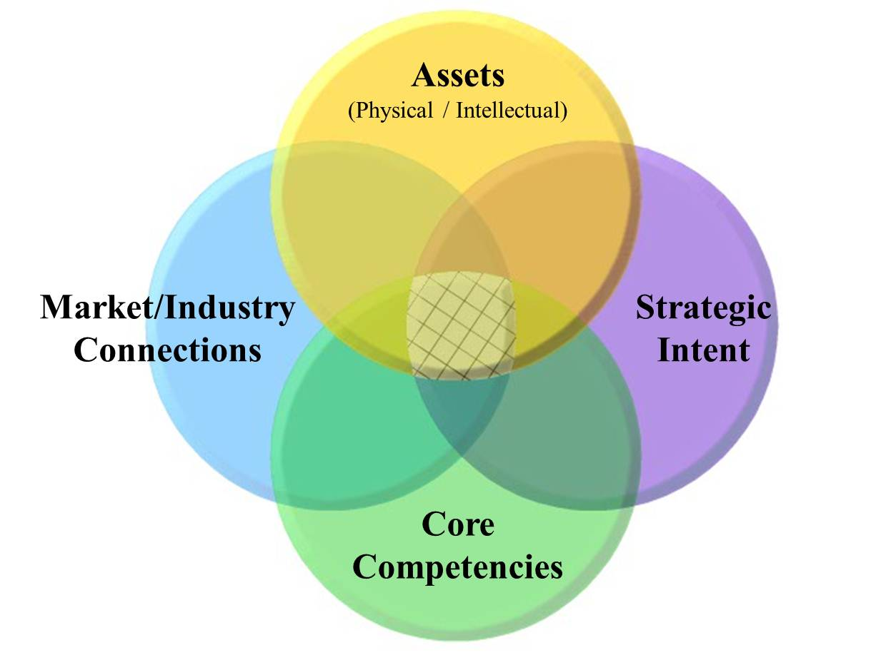
Capability Map: Foundation of Discovery
Team Capability Map
Corporate Capability Map
Notes:
“Capabilities” is used very specifically in the context of the Entrepreneurial arch. They include both ‘soft skills’ (horizontal bubbles) and ‘hard skills’ (vertical bubbles).

Slide 12
Let’s Start by examining the essence of a business

Slide 13
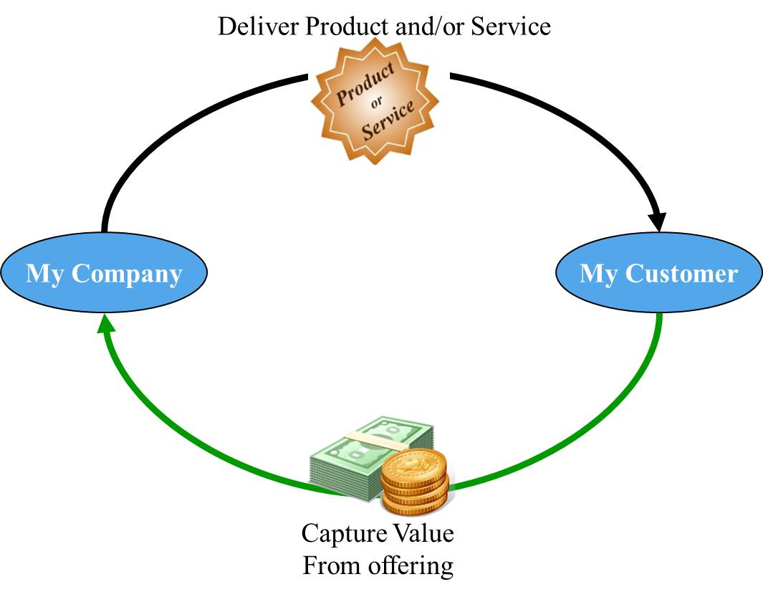
Typical Business
Notes:
Creating value is not enough; must capture enough of the created value to ensure the continuous operation of the enterprise

Slide 14
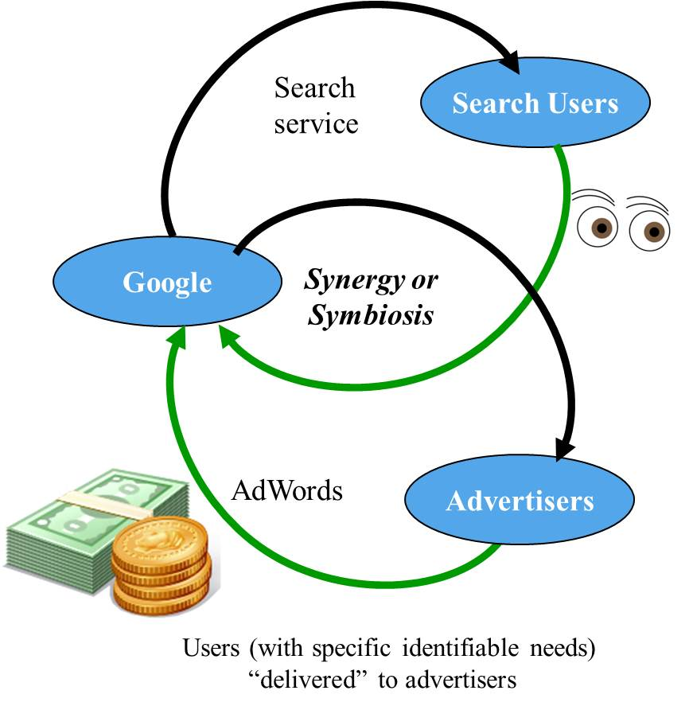
Multi-platform Business (ex. Google)
Specifically, this is a DUAL-platform business. You can theoretically there can be many platforms (hence, “multi-platforms”). Dual-platform business is the most common after the single-platform (“regular”) business. ALL Non-profits are Dual-platform businesses.

Slide 15
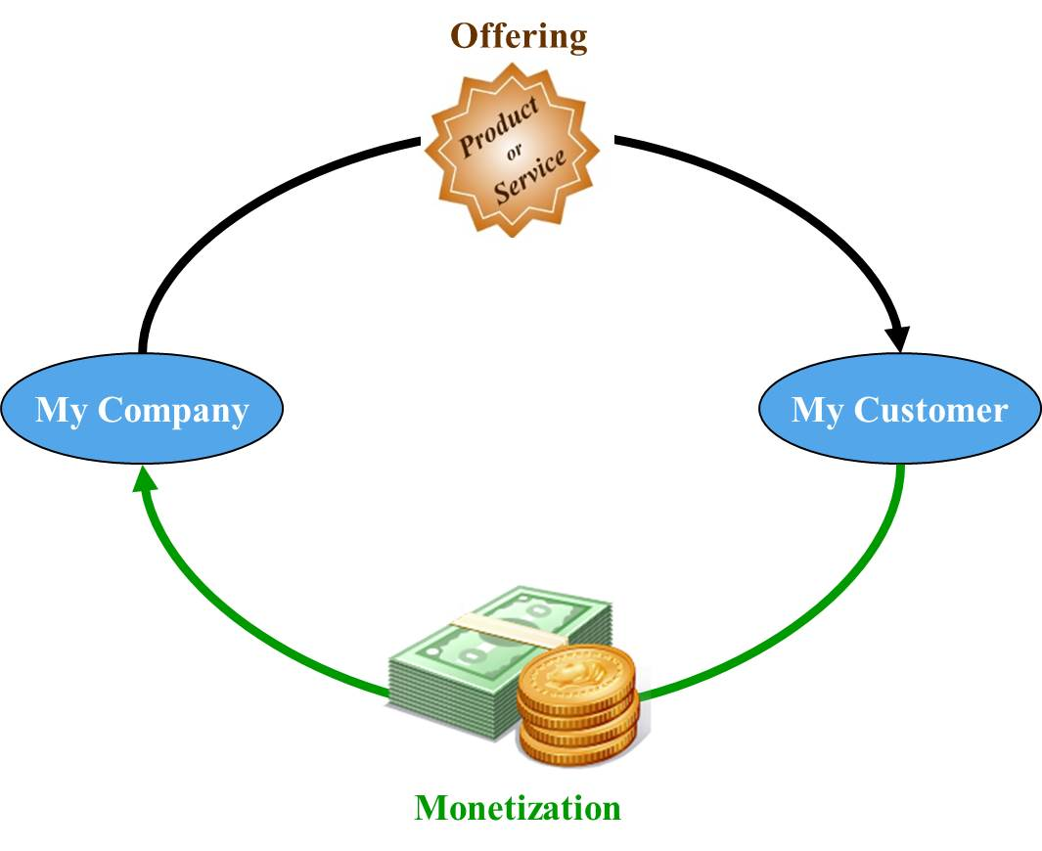
Focusing on a Simple Business (or the cash generating loop of a multi-platform business)

Slide 16
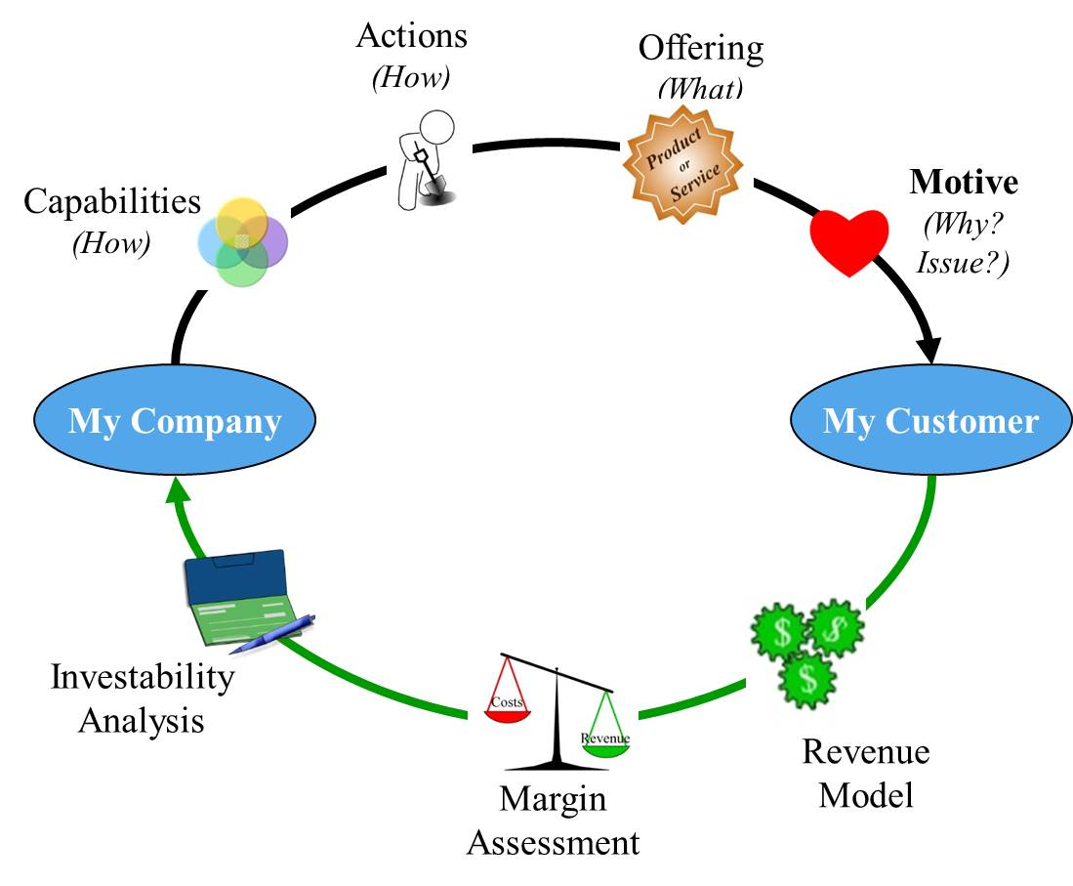
Zoom In slightly for a closer look
(i.e. Need/Desire)
Notes:
The venture’s offering is created by the actions the company performs. These actions are based on the firm’s capabilities. The customer must have a reason to adopt the new offering. It must solve a an unmet or under-met need/desire. Finally the monetization has three components from three perspectives. The revenue model is takes into account the customer’s perspective. The margin assessment is an internal to the company look (cost to sell must be more than the cost to produce), finally the third perspective is from the venture’s investors.

Slide 17
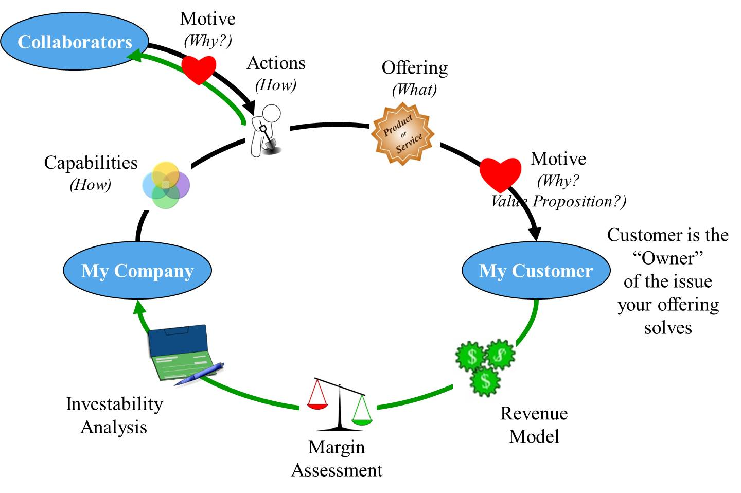
The Complete Business Model
Note: The new venture does not do everything itself in the creation and delivery of its offering to its customers. It leverages to existing business ecosystem.
(i.e. Need/Desire)
Detailed
and Quantitative

Slide 18
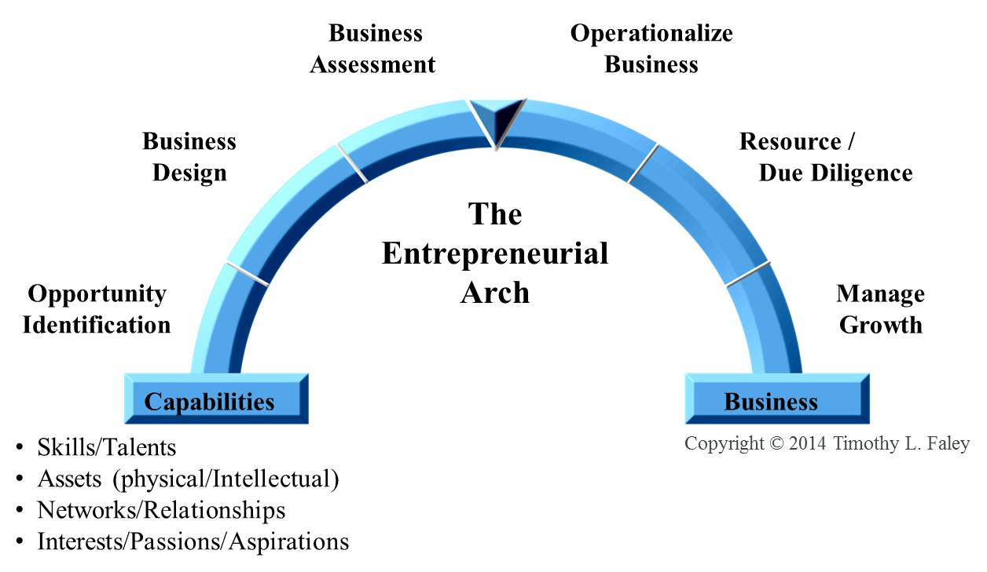
Business Assessment: Complete quantitative business model from which a feasibility study can be derived
Notes:
The assessment is a complete, quantitative business model. From that a Feasibility study can be created that includes a sensitivity analysis to all the major assumptions to understand which components of the business drive its economic viability.

Slide 19
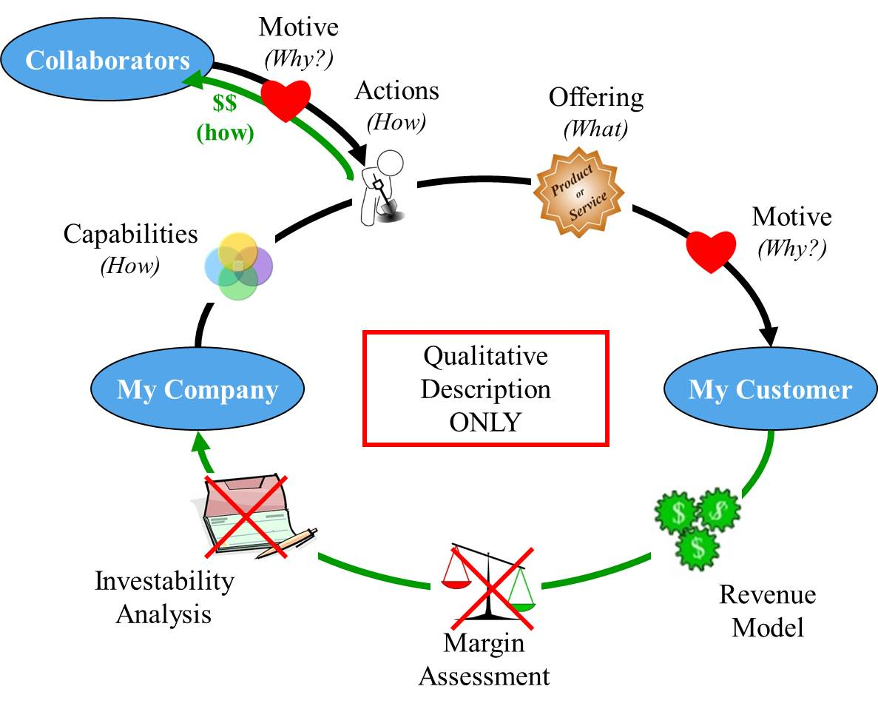
Zoom out to see only qualitative measures
(i.e. Need/Desire)
Notes:
Simultaneously doing quantitative and qualitative discovery can be confusing and overwhelming for the inexperienced entrepreneur. By zooming out and first examining only the qualitative components allow you to be more creative and less constrained by the numbers.

Slide 20
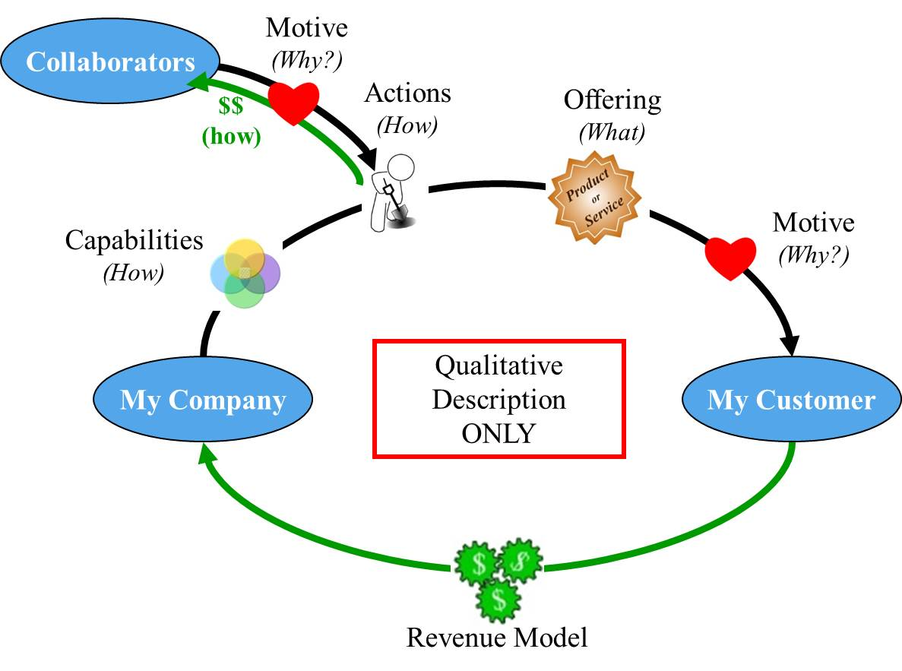
Business Construct: Specific, qualitative description
Notes:
This qualitative-only business description is not a complete business model. At the University of Michigan, we have call this qualitative-business model the “Business Construct.”

Slide 21
Business Design: Qualitative (only) description of the business
Notes:
The determination of the “Business Construct” occurs in the “Business Design” segment of the arch. “Design” as in the business is fully articulated before any more detailed work is completed.

Slide 22
Business Design Output: The Business Construct
(i.e. Need/Desire)

Slide 23
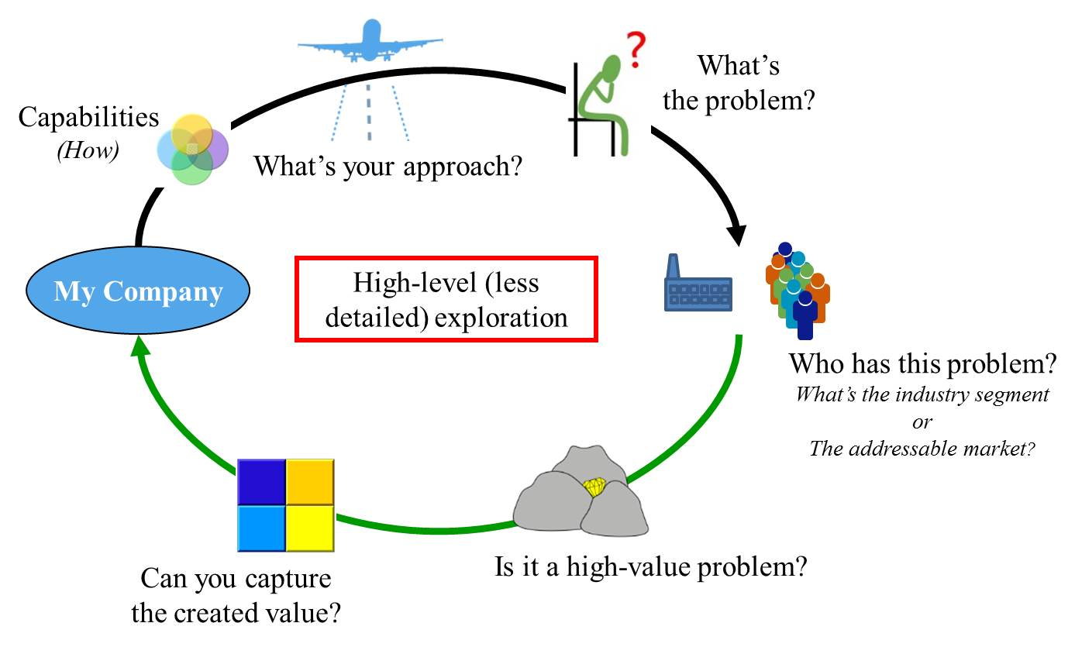
Zoom Out from the Business Construct for a broader perspective: This is Opportunity Identification
Notes:
Zooming out from the qualitative description of the business produces a high-level (albeit less detailed) look. Zooming out widens the field of view while lessoning the amount of detail that can be observed. An approach to solving a problem is determined before a specific offering is detailed in the Business Design segment. The customer is not known in detail, but the industry segment or addressable market that has an identifiable problem is known a the end of this level.

Slide 24
Opportunity Identification: Broad, exploratory phase. Grounded on organization’s capabilities.
Notes:
This zoomed-out exploratory level is called “Opportunity Identification”

Slide 25
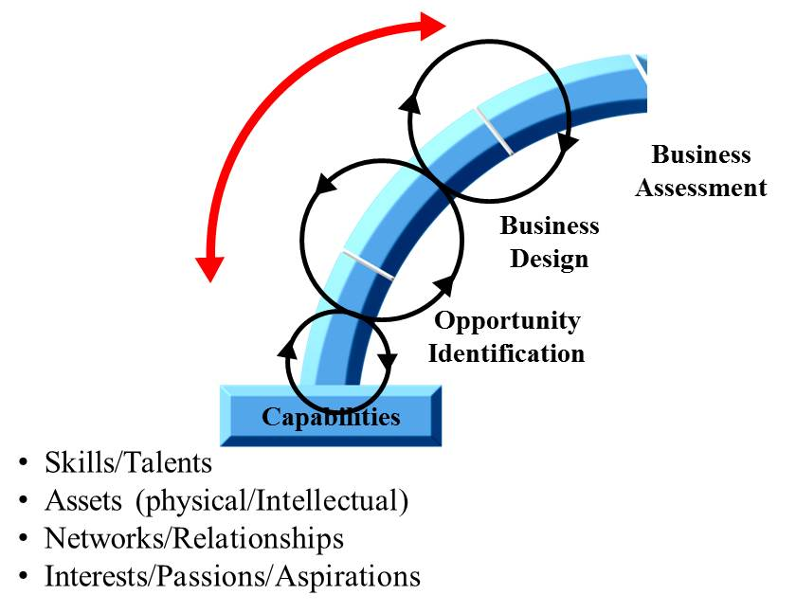
Moving Across the Arch’s Discovery Section…
…Means Zooming In and Out (changing perspective and the amount of detail)
Notes:
Clearly this is not a linear process, but one market by iterations between the segments. Breaking the process down into detailed steps prevents it from becoming overwhelming and focuses the entrepreneur on gathering enough information to decide whether or not to move to the next stage. Hence you are not worrying about go-to-market strategies when you are in Business Design, nor are you concerned about specific offerings when you are doing the wide exploration of Opportunity Identification.

Slide 26
Zooming in and out
Big Picture
Broad perspective (wide field of view)
Few details
Narrow perspective
Detailed examination (narrow field of view)
Many details, little perspective
See Short Video Clip on Perspective:
http://www.ispot.tv/ad/7b6H/deutsche-bank-perspective

Slide 27
Changing Perspective: Zooming In and Out
The World
The Forest
Zooming In/Out
The Tree
The Leaf

Slide 28
Discussion
E-mail me:
Tfaley@uvi.edu
Remember to put “ENT 205” in the “Subject Line” of the e-mail

