Slide 1
ENT 205
Introduction to
Innovation and Entrepreneurship
Course Introduction
Part B: Course Content
Dr. Tim Faley
Kiril Sokoloff Distinguished Professor of Entrepreneurship
Special Assistant to the President for Entrepreneurial Initiatives
University of the Virgin Islands
Tfaley@UVI.edu

Slide 2
What is an Innovation?

Slide 3
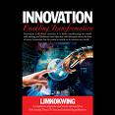
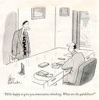
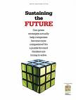
Ubiquitous Innovation ?
Robots in the workplace: Threat or Opportunity
Enterprise Innovation- July 28, 2016
Solar Innovations, Inc. Announces a New Product Innovation
--5/4/09
Four Ways Innovation has Shaped the Rio Olympics
Washing Post August 22, 2016
Is the recession suffocating American innovation?
AP 5/5/09
Wisconsin companies provide innovation in the fight against flu

Slide 4
What is an Innovation?
More than something new (invention)
Something new that has impact⁽¹⁾
Perceived as “new” by the adopter⁽²⁾
Commercial Perspective
“Research is the transformation of money into knowledge. Innovation is the transformation of knowledge into money.”
-- Dr. Geoffrey Nicholson, 3M
“Impact” is like “Value” – lots of ways to measure it!
Ref: (1): Anthony, Scott (2012), The Little Black Book of Innovation: How it Works, How to Do it, Harvard Business School Publishing Corporation
(2) Rogers, Everett (1995) Diffusion of Innovation (5th edition), p 12. “perception of ‘new’ by the adopter,” Free Press.
Notes:
Product Innovation: You do NOT need ANY of the products you currently use. What you NEED is WHAT they DO for you.
Henry Ford quote: People want a “faster horse”
Apple created the iPad by asking people what they USED a laptop for… not what they wanted in a new one (too limited a scope; too narrow a DESIGN BRIEF)

Slide 5
Creating Impact
What does it take for something to have impact?
What does it take for there to be a problem?
No problem, if someone does not have the issue
No impact unless someone adopts the solution

Slide 6
Innovation = Impactful Problem-solving
No Person, No Problem
No adoption, No Impact
No Impact, No Innovation

Slide 7
Innovation is…
Impactful Problem-solving that leverages something new
New Product
New Service
New Approach
New…. something

Slide 8
Innovation is NOT…
Innovation is NOT Entrepreneurship
Can develop a business that creates impact that is not “new”
Ex. franchise business
Innovation is NOT Creativity
Can create something new that has no adoption and therefore no impact

Slide 9
Why is innovation important?

Slide 10
Innovation’s Importance to Business
Innovation is important in ALL aspects of our live (personal, community, government, non-profit, small business, corporations)
Easiest to quantifiably measure “impact” in Business
“Businesses must be able to innovate or else their competitors will render them obsolete.”
Peter Drucker, Business Strategist
“Innovate or die.” – Tim Cook, CEO of Apple

Slide 11
Why is Innovating so darn hard?

Slide 12
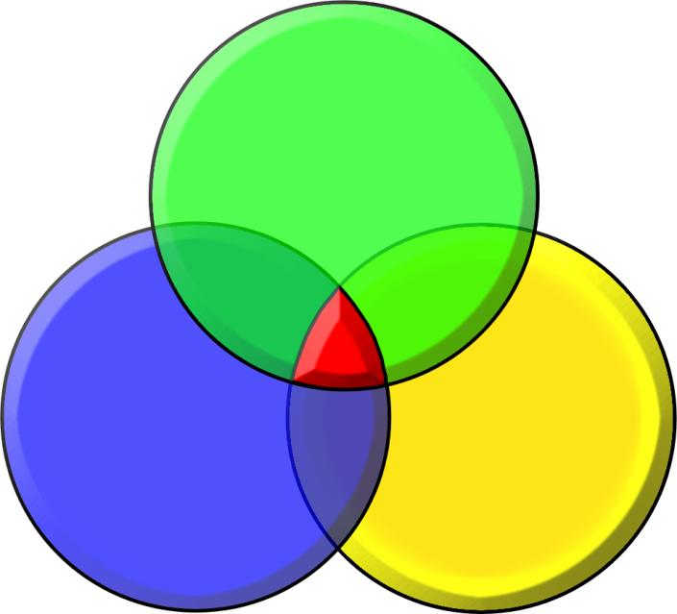
Innovating Requires 3 Major Parts
Getting things done
through organizations:
CREATIVE
LEADERSHIP
PEOPLE
METHODOLGY
ENVIRONMENT
In other words: 3Ps == People, Process, and Place
Notes:
“Process” implies “recipe” which is not the case; method is a way to approach

Slide 13
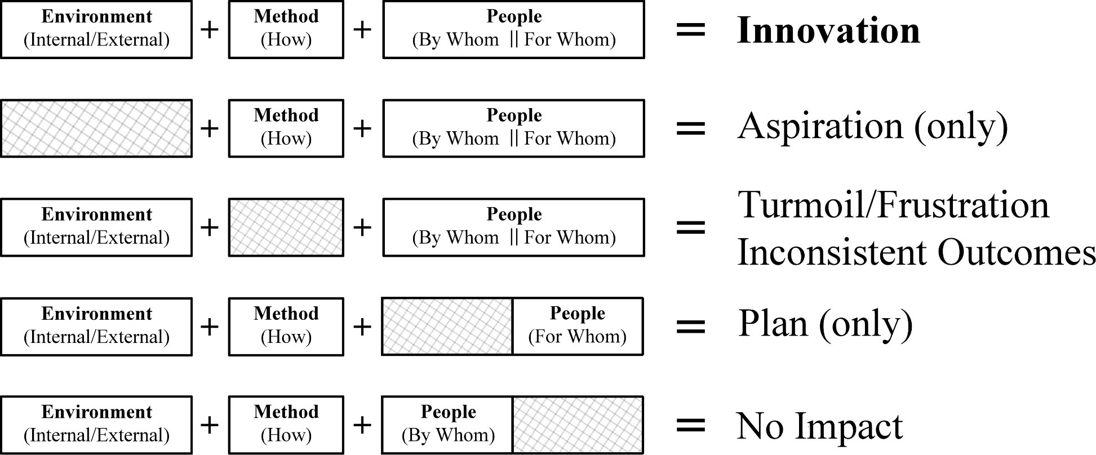
Need all three components

Slide 14
Transitioning from Innovation to Entrepreneurship
Innovation Creates Value (leveraging something new)
Entrepreneurship Creates and Captures Value

Slide 15
Entrepreneurship Focus
Discovering Innovative New Businesses
However the basic process holds the same for products and economies
We will focus ONLY on the “Discovery” (left-hand) side of the Entrepreneurial Arch in this course

Slide 16
Building a Business is a Process: Stochastic, iterative one, but still a process
Business Development
Operationalize Business
Business Execution
Resource /
Due Diligence
?
Manage Growth
Capabilities
Business
Skills/Talents
Assets (physical/Intellectual)
Networks/Relationships
Interests/Passions/Aspirations
Copyright © 2012 by Timothy L. Faley
Notes:
Entrepreneurship courses typically start with business planning or other similar courses aimed at assisting the entrepreneur in operationalizing their business. However most entrepreneurs start with a set of capabilities – things they love doing – that they would like to earn a living from. What is missing is the business discovery portion of this process.

Slide 17
Building a Business is a Process:: Stochastic, iterative one, but still a process
Business
Assessment
Operationalize Business
Resource /
Due Diligence
Is it worth doing?
Manage Growth
Business
Copyright © 2012 by Timothy L. Faley
Notes:
The first step that must occur before operationalizing a business is to determine if that business is worth executing.

Slide 18
Building a Business is a Process:: Stochastic, iterative one, but still a process
Business
Assessment
Operationalize Business
Business Design
Resource /
Due Diligence
What is “it”?
Manage Growth
Business
Copyright © 2012 by Timothy L. Faley
Notes:
Before you can determine whether it is feasible, you need a clearer definition of precisely what “it” is.

Slide 19
Building a Business is a Process: Stochastic, iterative one, but still a process
Business
Assessment
Operationalize Business
Business Design
Resource /
Due Diligence
Opportunity
Identification
Manage Growth
What problem are you solving?
Business
Copyright © 2012 by Timothy L. Faley
Notes:
The business solves a problem, satisfies a need or a desire. Before you design the business, you should know what it is trying to accomplish. That is opportunity identification.

Slide 20
Building a Business is a Process:: Stochastic, iterative one, but still a process
Business
Assessment
Operationalize Business
Business Design
Resource /
Due Diligence
The
Entrepreneurial
Arch
Opportunity
Identification
Manage Growth
Capabilities
Business
Skills/Talents
Assets (physical/Intellectual)
Networks/Relationships
Interests/Passions/Aspirations
Copyright © 2014 Timothy L. Faley
Copyright © 2012 by Timothy L. Faley
Notes:
All the left-hand side of the arch supported by the team’s or the organization’s capabilities.

Slide 21
Building a Business is a Process:: Stochastic, iterative one, but still a process
Business Development
Business
Assessment
Operationalize Business
Business Execution
Business Design
Resource /
Due Diligence
The
Entrepreneurial
Arch
Opportunity
Identification
Manage Growth
Capabilities
Business
Skills/Talents
Assets (physical/Intellectual)
Networks/Relationships
Interests/Passions/Aspirations
Copyright © 2014 Timothy L. Faley
Copyright © 2012 by Timothy L. Faley
Notes:
All the left-hand side of the arch supported by the team’s or the organization’s capabilities.

Slide 22
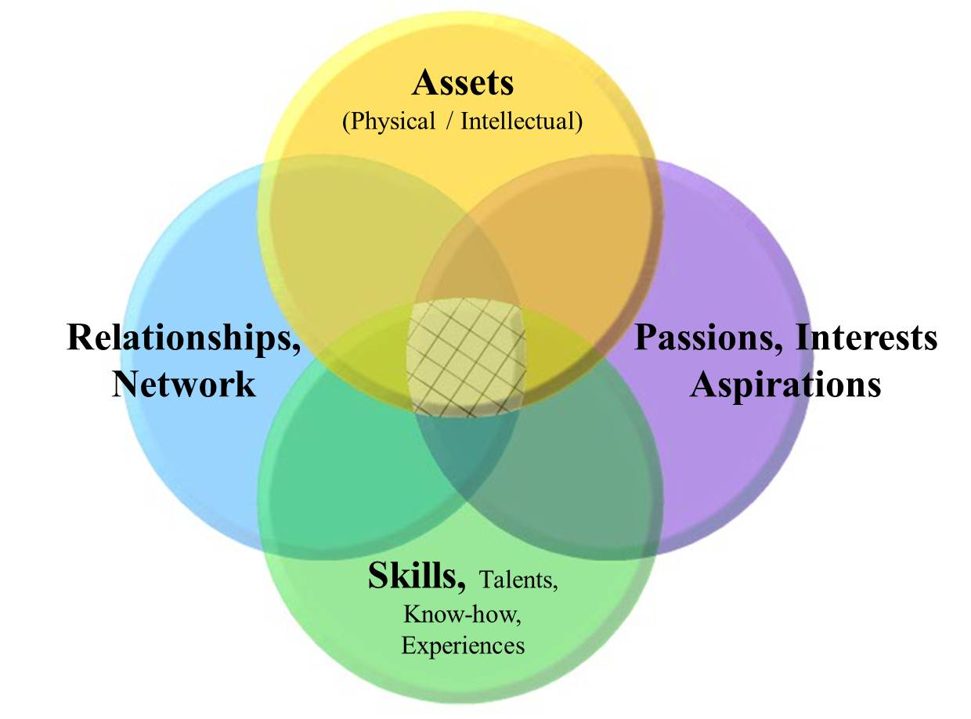
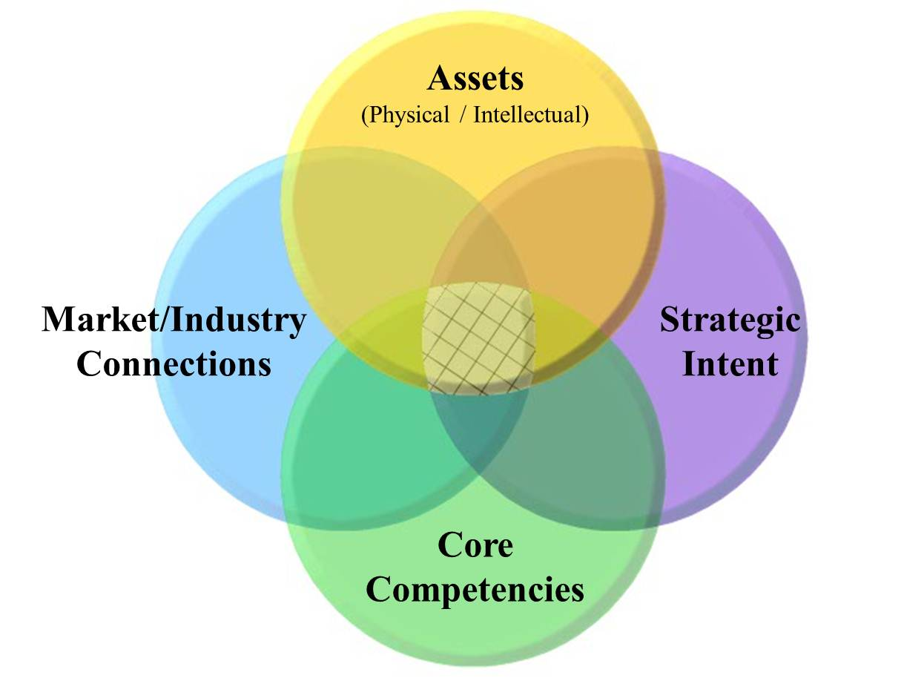
Capability Map: Foundation of Discovery
Team Capability Map
Corporate Capability Map
Notes:
“Capabilities” is used very specifically in the context of the Entrepreneurial arch. They include both ‘soft skills’ (horizontal bubbles) and ‘hard skills’ (vertical bubbles).

Slide 23
Entrepreneurship Courses
Business Development
Business
Assessment
Operationalize Business
Business Execution
Business Design
Resource /
Due Diligence
The
Entrepreneurial
Arch
Opportunity
Identification
Manage Growth
Capabilities
Business
Skills/Talents
Assets (physical/Intellectual)
Networks/Relationships
Interests/Passions/Aspirations
Copyright © 2014 Timothy L. Faley
ENT 205: Mind-set, Skill-set & Left-hand side of Arch
ENT 300: Business Discovery --- i.e. The left side of arch
ENT 301: Planning and Resourcing a new firm
ENT 304: Entrepreneurial Marketing
ENT 306: Entrepreneurial Finance (Resourcing)
ENT 308: Growth & Renewal Strategies
MGT 213: Management & Growing an existing business
Copyright © 2012 by Timothy L. Faley
Notes:
All the left-hand side of the arch supported by the team’s or the organization’s capabilities.

Slide 24
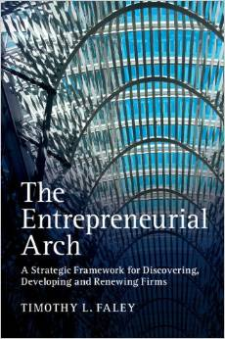
Cambridge Press, 2014
Available at:
www.Amazon.com

Slide 25
Questions?
What do you find confusing?
What questions do you have?
Send me an e-mail.
Make sure to put “ENT 205” in the subject line of the e-mail!

