Slide 1
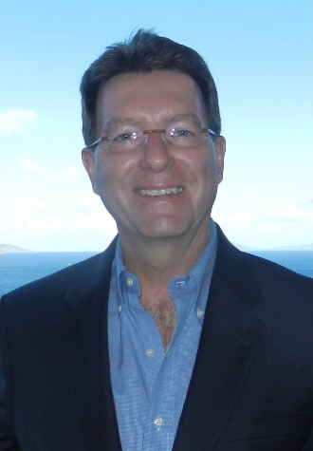
ENT 205
Introduction to
Innovation and Entrepreneurship
Your Instructor:
Dr. Tim Faley
Kiril Sokoloff Distinguished Professor of Entrepreneurship
Special Assistant to the President for Entrepreneurial Initiatives
University of the Virgin Islands
Tfaley@UVI.edu

Slide 2
About me..
Consultant, author, financier, scientist, entrepreneur, researcher, and educator
Published in Journals, Magazines, Newspapers, Books
Focused on accelerating the creation and development of new products, processes, businesses and economies.
Half my career in industry, half in academia
Research, new business development, technology licensing, and corporate venture capital; associated with over 30 ventures
15-years at Univ. Michigan
Created #1 Graduate Program in Entrepreneurship in the Nation (Princeton Review, 2013)
AY22-23 will be my 10th year at UVI
Published by Cambridge University Press, 2015
Published by Cambridge University Press, Jan. 2021

Slide 3
Building an Innovation and Entrepreneurship System at UVI
UVI’s aim is to produce graduates who are academically excellent, globally sensitive, entrepreneurially focused, emotionally and spiritually balanced, and committed to serving the world. (Goal 2A)
Entrepreneurship is a mindset and a skill-set that will benefit EVERY Student, regardless of career path

Slide 4
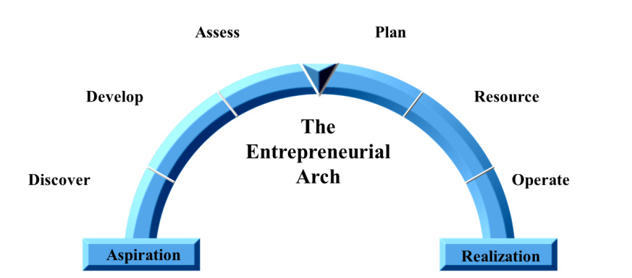
I&E@UVI: A Fully Integrated Program
Cross-campus; impacting all majors
Graduate “Entrepreneurial Focused” students
Mind-set and Skill-set based
Fully integrated across entire spectrum of I&E skills
Combination of Courses (both for-credit and non-credit) and experiential programs
Both a Minor (18 credits), and Certificate (9 credits) available
I&E Club (UVIDEA)
3 externally-funded experiential programs and growing
Programs supported by 2 Innovation Centers

Slide 5
Continuum of Product & Business Development
Product Development
Business Development
Problem Concept Mock-up Prototype Business Design Plan Execution
Hackathons
All UVI
Programs
Supported by
Innovation Centers
Business Design Grant Program
13D Business Launch Competition

Slide 6
Course Philosophy
Innovation and Entrepreneurship is a LEARNERABLE skillset and mindset
Are some people “gifted”?
Sure…. but
But like teaching music or surgery, it can be taught and learned!

Slide 7
Maximizing your personal effort
What We Do Well
This is
Education
Learn to do this better
Learn to say “No”
What We Want To Do
Hooray!
What We Can Be Paid To Do
Learn to Monetize
This is an
Entrepreneurial Skill
Ref: Bud Caddell

Slide 8
Next Slide Deck…
00A_ENT205_Course Intro
Will introduce course content
Questions?
E-mail me!

