Slide 1
Business
Assessment
Session 10
Business Assessment
Part II: Financial Assessment
Dr. Tim Faley
University of the Virgin Islands
Tfaley@uvi.edu

Slide 2
Part II: Financial Assessment Income Statement Creation Margin Assessment Investability Assessment Operating Break-even Assessment Start-up Cost Estimating Investment Break-even Assessment (i.e. Investor Perspective)
Part II: Financial Assessment
Is OPTIONAL
Part II: Financial Assessment
Is OPTIONAL

Slide 3
Assessment: Quantitative Business Model and assessment
Collaborators
Motive
(Why?)
$$
(how)
Actions
(How)
Offering
(What)
Capabilities
(How)
Motive
(Why?
Value Proposition?)
(ie. Need/Desire)
Customer is the
“Owner”
of the issue
your offering
solves
My Company
Detailed
and Quantitative
My Customer
Investability
Analysis
Revenue
Model
Margin
Assessment

Slide 4
Income Statement (annual)
Revenue ($)
-- Cost of Labor
-- Cost of Materials
-- Depreciation of mfg equip.
===================
Gross Profit ($)
-- Cost of Sales, General & Admin (SG&A)
-- Research and Development (R&D, if on-going)
===================
Operating Income ($)
Cost of Goods Sold (COGS)

Slide 5
Common-sized Income Statement
Revenue (100%)
-- COGS Margin (% of Revenue)
===================
Gross Margin (% of revenue)
-- SG&A Margin (% of Revenue)
===================
Operating Income Margin (% of Revenue)

Slide 6
Estimate your Income Statement (app co)
Revenue ($1000 per app)
-- Cost of Labor ($100 per app)
-- Cost of Materials ($5)
-- Depreciation of mfg equip.
($3000 computer/5 years/20 apps per year = $30 per app)
===================
Gross Profit ($865 per app)
-- Cost of Sales, General & Admin ($500/app)
===================
Operating Income ($365 per app)

Slide 7
Common-sized Income Statement (app co)
Revenue (100%)
-- COGS (13.5%)
===================
Gross Profit Margin (86.5%)
-- SG&A Margin (50%)
===================
Operating Income Margin (36.5%)
How good are these estimates?
Compare to a similar company that is currently operating that has a similar offering

Slide 8
Comparable Companies
Try to find a “pure” comparable company (preferably public) that compares to your business
“The Wicker Basket Company” (narrow focus)
versus the “Consolidated Miscellaneous Companies Conglomerate”
(broad focus)
Typically not a company you have heard about
NOT a Fortune 500 company
NOT a private company or startup
Takes some time to find a good comparable
This public company is known as “Comp” (comparable) firm or you could say you are using it as a “proxy” to your firm’s financials (%’s not $’s!)

Slide 9
Gathering Financial Information From Public Companies
Entire Slide Deck on this topic if you want more information

Slide 10
Financial Data Sources
Public firms
Google.com/finance
Morningstar Financials
http://financials.morningstar.com/

Slide 11
Example: AutoDesk
Go to Website
Morningstar financial
http://financials.morningstar.com/
Then, Click on “go” icon
Find AutoDesk

Slide 12
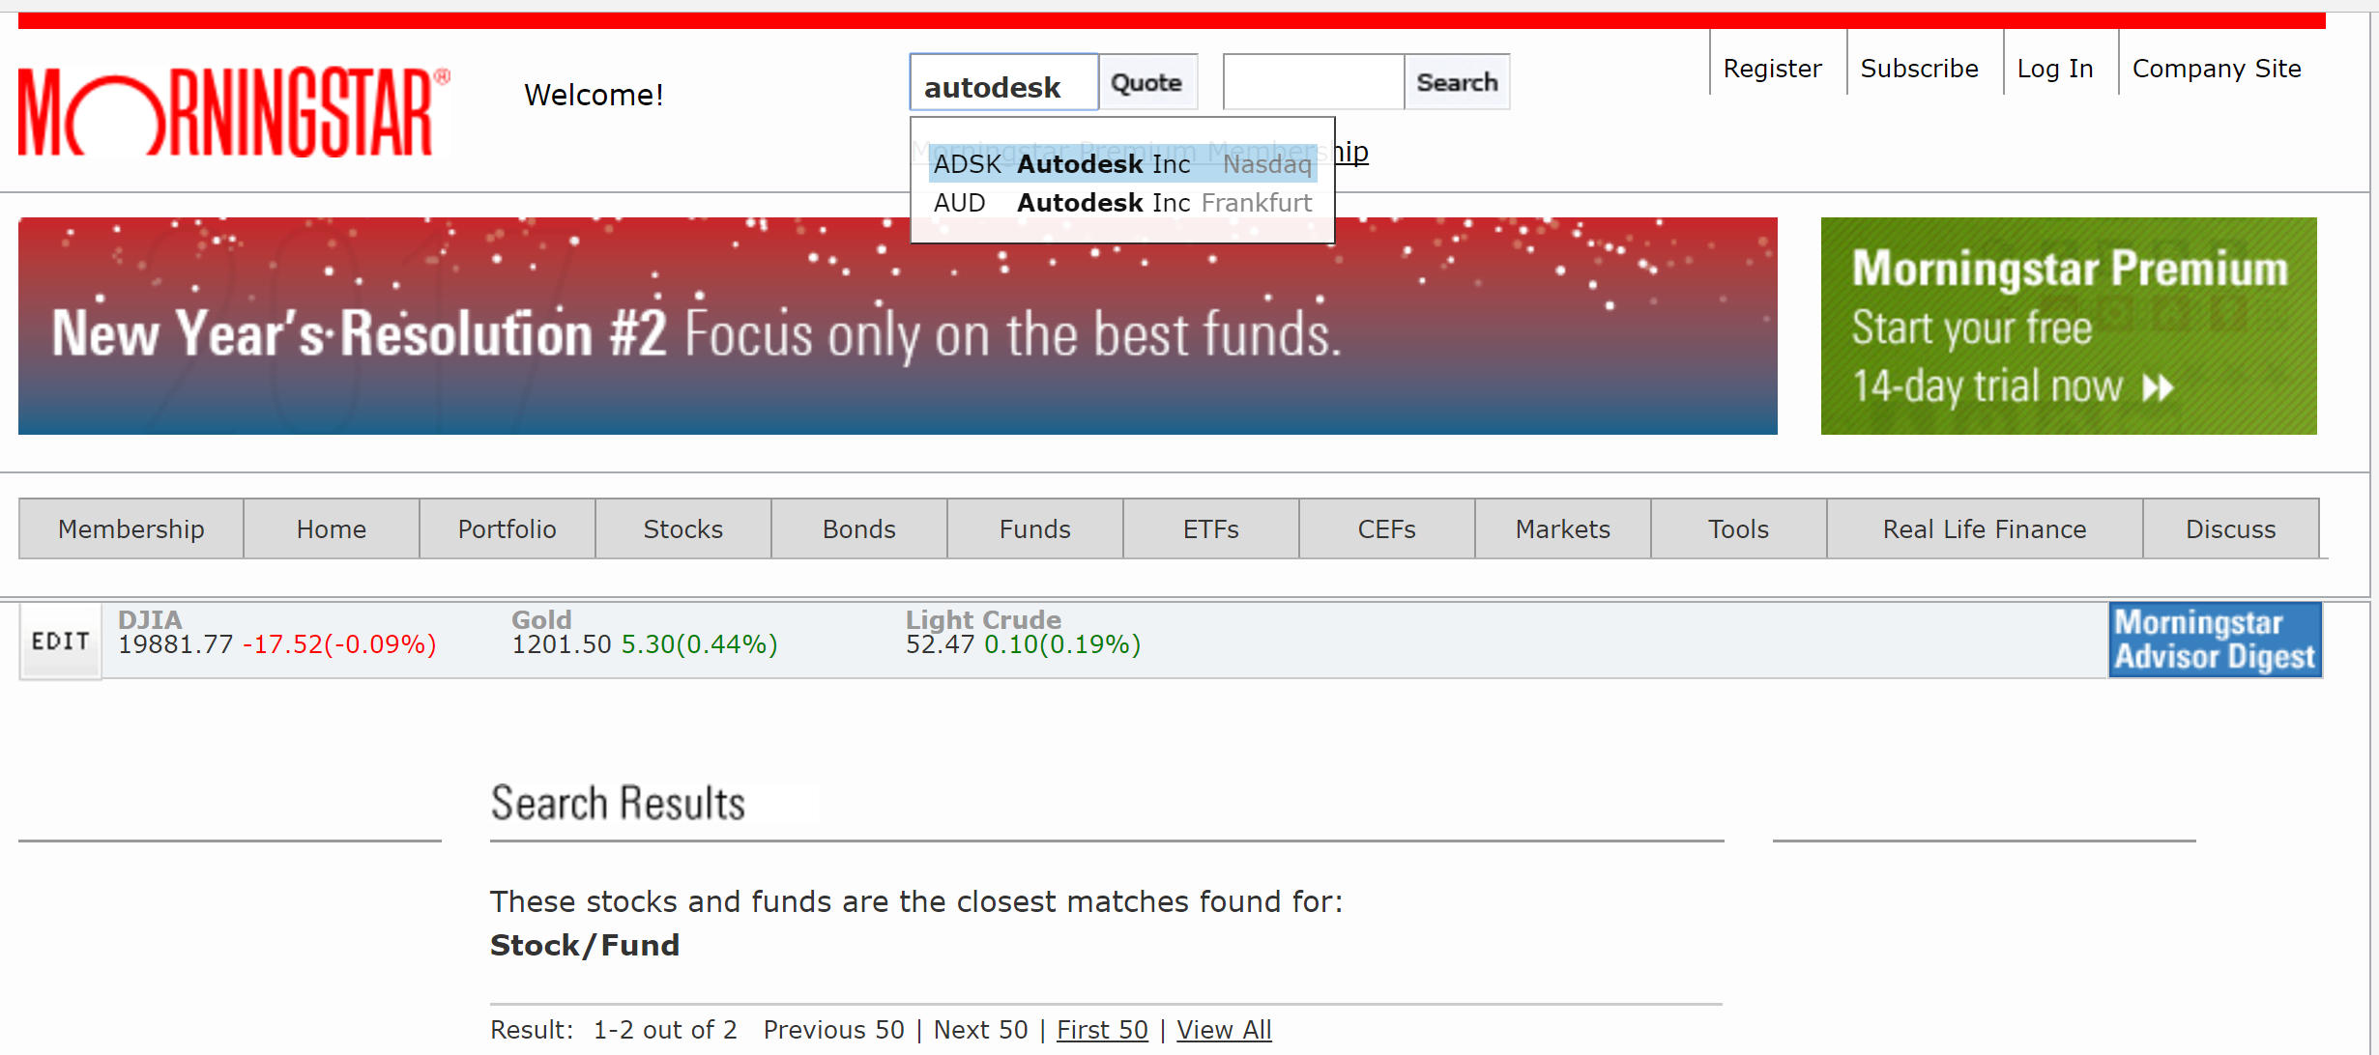
Company Look-up on Morningstar site
1. Type “Audodesk” into the “Quote” box
2. Select and click on “Nasdaq” listing
(Ticker symbol: ADSK)

Slide 13
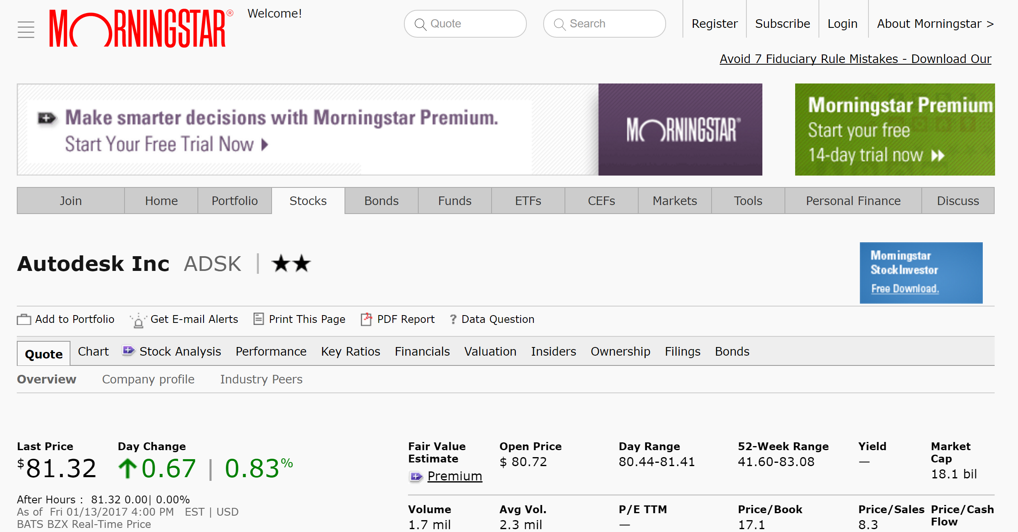
Finding ratio data
Tabs

Slide 14
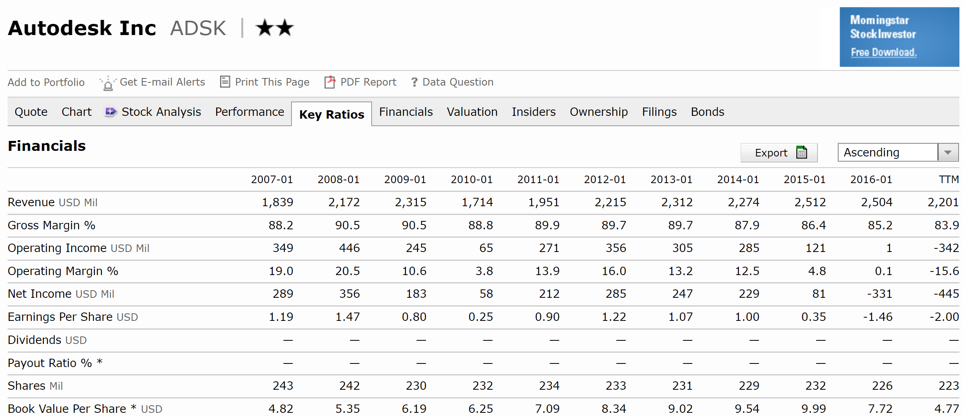
Autodesk I/S Margin Values

Slide 15
Autodesk for January 2014
Revenue (100%)
-- COGS Margin (12.1% of Revenue)
===================
Gross Margin (87.9% of revenue)
-- SG&A Margin (75.4% of Revenue)
===================
Operating Margin (12.5% of Revenue)
Back-calculate: 100-87.9=12.1
From Morningstar website (previous slide)
Back-calculate: 87.9-12.5=75.4
From Morningstar website (previous slide)
Margin Assessment Completed and have a “reality check” of
your estimates to another company in your space!

Slide 16
Compare Autodesk to your App startup
App Startup
AutoDesk
COGS: 13.5% of Revenue
Gross Margin: 86.5%
SG&A: 50%
Operating Margin: 36.5%
COGS: 12.1% of Revenue
Gross Margin: 87.9%
SG&A: 75.4%
Operating Margin: 12.5%
Conclusion: Probably UNDERESTIMATED SG&A Costs for Your Startup

Slide 17
Investablility Analysis

Slide 18
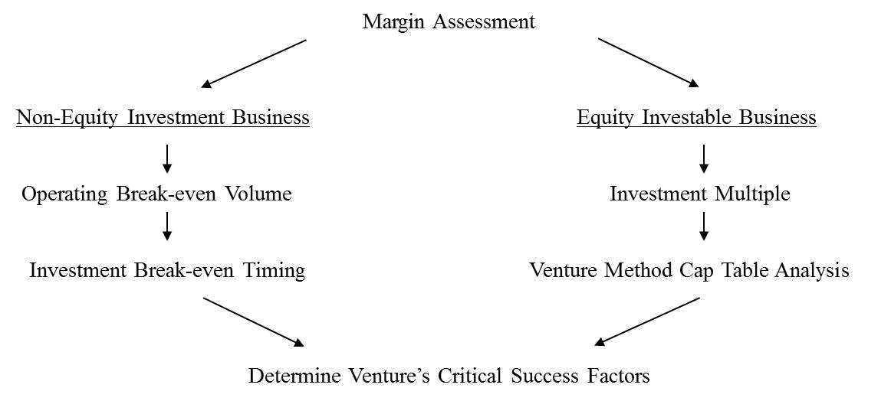
Investability Analysis
Take this path for businesses
Starting with a loan or
bootstrapping

Slide 19
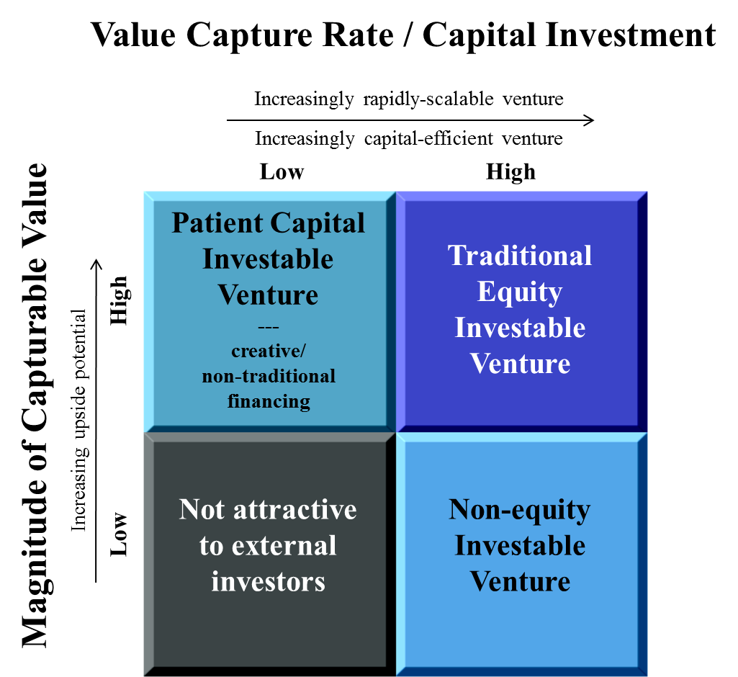
Investment Potential Framework: Determines Type of Investment
Market size
Times
Profitability

Slide 20
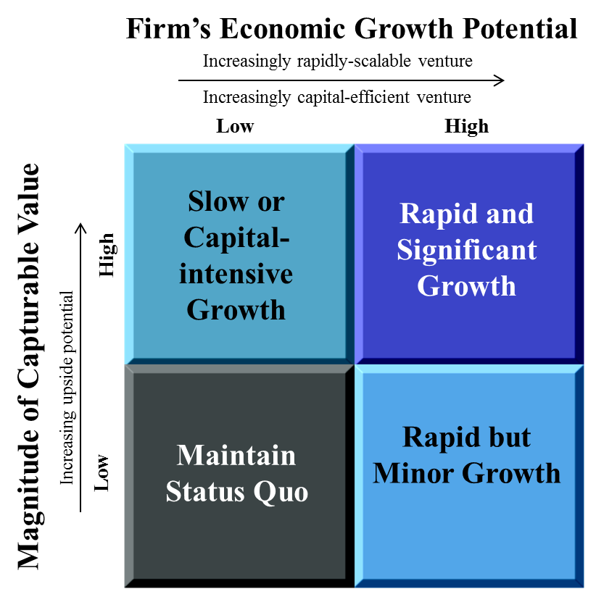
Investment Potential is dependent upon the firm’s growth potential
Market size
Times
Profitability

Slide 21
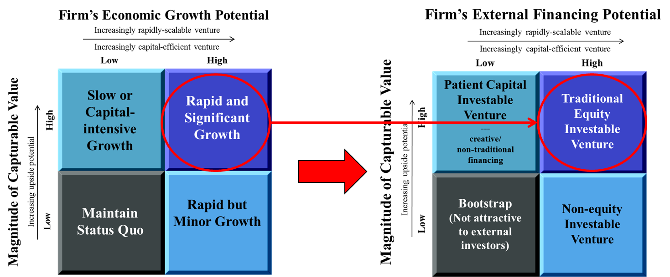
Connecting Growth and Investability
Each of the 4 Quadrants here Maps its equivalent quadrants here

Slide 22
Investability Analysis
Take this path for businesses
Starting with a loan or
bootstrapping

Slide 23
Break-even Analysis

Slide 24
Non-equity Financial Screens
Operating Break-even Volume (subject of this session)
Looks only at operating costs (fixed and variable). The operating break-even determines how many units you will need to sell in order to break-even. This view can be assessed on any basis, weekly, monthly, or yearly, for example. The basis is whatever makes sense for the business. It breaks down the expenses of the business into variable and fixed costs. Fixed costs include such things as rent, insurance, and perhaps salaries. Variable costs include product material costs, taxes, and salaries if paid on a commission or piece-work basis. The break-even volume is the volume at which the fixed plus variables costs matches the total revenue.
Investment Break-even Timing (next level of feasibility)
Takes into account the entire Investment that is made in the company (beyond operating fixed costs). How long does it take to cumulate enough Operating Income to cover that investment?

Slide 25
Fixed and Variable Expenses
Fixed Expenses
Salaries
Payroll tax
Benefits
Rent
Utilities
Licenses & fees
Insurance
Advertising
Legal & Accounting
Depreciation
Interest
Maintenance & cleaning
Variable Expenses
Sales commission
Sales tax
Office supplies
Travel
Entertainment
Shipping
Overtime
Bad debt
Mixed Expenses
Telephone
Postage

Slide 26
Operating Break-even Volume
Total Revenue
Break-Even Volume
Total Costs = Fixed + Variable
$
Fixed Costs
0
0
Increasing # of Units

Slide 27
Example
As an example, my wife has a small art-based business where she sells hand-made items that are based on her original art. She knows the cost of goods for each item ($2), based on the materials and the amount of her labor that goes into its production. This portion of her labor is variable. She then sells these items at local art fairs ($5 each). These fairs charge a booth fee (fixed cost, $500) and she often will hire an assistant at a fixed price per show (another fixed cost, $100). She can then determine how many items she will need to sell at any given art fair in order for that fair to create value for her. If that is a reasonable number, significantly less than the target market, for example, then it becomes a worthy endeavor. Otherwise she should re-evaluate her pricing strategy or the business itself.

Slide 28
Operating Break-even Analysis
Fixed Costs
SG&A
Booth Fee: $500
Marketing Labor: $100
TOTAL = $600
Gross Profit per item
Revenue: $5
COGS: $2
Gross Profit = $3/item
$600 / ($3.00/item) = 200 items to break even

Slide 29
Operating Break-even Reality Check
Operating Break-even volume should be:
Much, much less (say 10% or so) than the target market

Slide 30
Investment Break-even Timing
1. Estimate the firm’s annual profitability
Income statement in $’s
Convert Income Statement numbers to annual if not already
2. Estimate Business’ Startup costs
Equipment that you need to purchase up-front
Licenses you may have to obtain
Up-front rental fees / deposits for building
Web-site creation
Etc.

Slide 31
Investment break-even timing example
Let’s say Kelley believes she can earn a net operating profit after tax of $100 per art show.
She has a small investment in this business: computer, printer, tent, and a few items to aid in the display her products. We will say that these items represent a $7,000 up-front investment in her business.
Even though we determined that she is profitable at each fair, it would then take her 70 art fairs in order to achieve cash-flow break even ($7000/$100 per show).
If she averages seven shows a year, that would take 10 years. (Good value is less than 3 years)
And this is before discounting the future revenue streams, which would further lengthen the pay-back time! She may want to consider re-positioning this business.

Slide 32
Break-even summary (1 of 2)
First financial screen of all firms should be a margin analysis
Can you sell the product or service for less than it costs to produce it and deliver it to your customer
EBITDA or Operating margins work well for this test
The first financial screen for non-equity (debt) financing or bootstrap firm is operational break-even. How many units do you need to sell over a give period to cover your costs (fixed and variable; direct and indirect) over the same period

Slide 33
Break-even summary (2 of 2)
If this operating break-even value is not much, much less than the target market (around 10% is good) then the company must be repositioned
Passing this screen is not “the end.” Investment break-even is the next feasibility test of the business.
Doing a “what-if” sensitivity analysis on these calculations can then help you determine the startup’s critical success values (not covered)

Slide 34
Assessment: Quantitative Business Model and assessment
Collaborators
Motive
(Why?)
$$
(how)
Actions
(How)
Offering
(What)
Capabilities
(How)
Motive
(Why?
Value Proposition?)
(ie. Need/Desire)
Customer is the
“Owner”
of the issue
your offering
solves
My Company
Detailed
and Quantitative
My Customer
Investability
Analysis
Revenue
Model
Margin
Assessment

Slide 35
Investability Analysis
Take this path for businesses
Starting with a loan or
bootstrapping

Slide 36
End of course material
Thanks for your attention!

