Slide 1
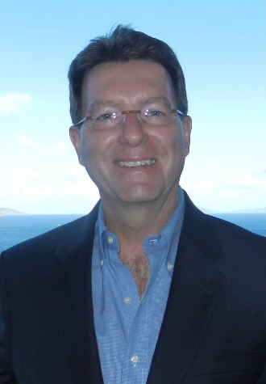
Business
Design
Session 9
Business Design
Part II (voice-over only)
Dr. Tim Faley
University of the Virgin Islands
Tfaley@uvi.edu

Slide 2
Business Design Methodology (5-steps)
Step 1: Diagnose (understand root-cause need)
Step 2: Prescribe (propose a product/service offering)

Slide 3
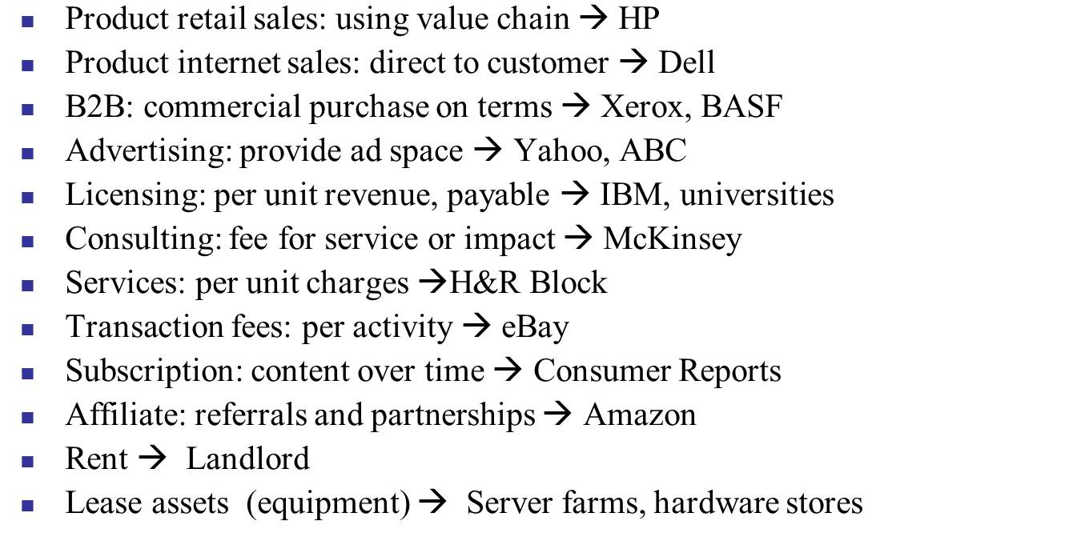
Business Design Methodology (3/5)
Step 3. MONETIZE: Identify revenue model for the offering
Revenue model consistent with customer/needs?
Validate with more elicitations as necessary
If none discovered, iterated to Step 2 (determine new offering) or Step 1 (new customer/need) pair

Slide 4
Business Design Methodology (4/5)
CUSTOMER
Step 4. OWNER/ACTIVITY: Develop customer adoption profiles (personas) across the adoption curve for target segment
What is minimal viable product (MVP) that meets the early adopter’s needs?
How do you move from early-adopters to later customers?
Does product change? If so, how?

Slide 5
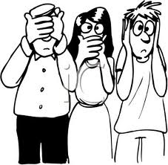
Adoption Curve
Late Adopters
Conservatives
Pragmatists
Visionaries
Innovators
Revenue
Adoption time
5

Slide 6
Target segments will vary over product adoption curve (and your product may as well… but not always)
Rain●X
Original windshield “wax” water repellant
Combination windshield cleaner/repellant

Slide 7
Persona Development…
See Appendix B of textbook for details

Slide 8
Business Design Methodology (5/5)
Step 5. ACTIVITY (2): Identify activities required to create offering and deliver to customer
Identify which activities your organization will perform
Perform PVC to ensure ability to capture value
If unsatisfactory, iterate to previous steps or back to Opportunity Identification
Identify collaborators
Identify their needs via elicitations
Determine value proposition for collaborators
Create collaborator position statement
Has the “customer” definition changed?
If so, return to Step 1
How will these activities change as you move from across the customer adoption curve?
Will new Capabilities need to be necessary as you progress?
If so, how will you obtain them?

Slide 9
What activities will your organization perform to create your offering?
What specifically does your company do?
Raw
Materials
Product Design
Mfg
Marketing
Sales
Distribution
Customer
Notes:
Outsource the manufacturing and Distribution and focus on the design, marketing ans sales, or vice versa? Depends on Capabilities and Aspirations.

Slide 10
Business Design Output: Crafting a High-level Business Framework
Business Construct (ie Qualitative Business Model)
Activities (of the business)
Offering (product/service):
What precisely is your product/service?
Actions your firm takes:
What precisely does the company do?
How does this leverage your Capabilities?
What activities do you leverage from the existing ecosystem?
Monetization (method of the business)
How does your company make money (revenue model)?
Value capture mechanism?
Owner (of the problem) Customer (Group the business SERVES)
Who (very specifically) are your customers and collaborators?
What is your target persona? (Need-based market segment?)
Motive (of the problem owner)
Why do your customers/collaborators buy your product / collaborate with you?
What value do you create/problem do you solve for the your customer and collaborator?
How does your offering compare to existing solution?
Business Perspective
Customer Perspective
Notes:
The “business construct” is the qualitative view of the business model. Not quite a business model, since it does not contain the quantitative parts (margins, investment). Clearly articulating and assessing the qualitative before jumping into and assessing the quantitative helps avoid getting ‘lost in the numbers.’

Slide 11
Quiz #5 on Session 9
See syllabus for target (“due”) date and “drop dead date” (date which beyond you will not be able to take this quiz and a zero will be recorded for score)

Slide 12
Questions? Confused?
E-mail me at:
Tfaley@UVI.edu
Make sure you put ENT 205 in the Subject Line of your e-mail!

Slide 13
Knowledge

Slide 14
The Wisdom Pyramid
Ability to perceive and evaluate the long-term consequences of behavior.
Contained in explanations. Answers “why” questions.
Wisdom
Contained in instructions. Consists of know-how & know-what.
Understanding
Knowledge
Contained in descriptions. Answers to questions who, what where, when, how many?
Information
Data
Products of observations of people or instruments
* Re-Creating the Corporation, Russell L. Ackoff (©1999)

Slide 15
Definitions
Wisdom
Meaning – What to do about it
Ability to perceive and evaluate the long-term consequences of behavior.
Understanding
Contained in explanations.
Causality – How and why the patterns exist
Dynamics and causality that allows plausible prediction
Answers “why” questions.
Knowledge
Contained in instructions.
What the patterns mean – the know-what and know-how
The classes, categories, causality, relationships, dynamics etc. that are used to create predictable future outcomes
Information
Contained in descriptions.
Patterns – How the data is organized
Data and observations captured in a form in which patterns can be discerned and processed
Answers to questions who, what where, when, how many?
Data
Products of observations of people or instruments
Measurements & facts about the world

Slide 16
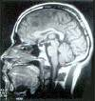
APCFB Model
F
i
l
t
e
r
s
Assumptions
Expectations
Beliefs
Values
EVENT
Perceptions
Defense Mechanisms
Behavior
Doing
Saying
Moving
Conclusions
Filter
Feelings

Slide 17
Cognitive Dissonance
Cognitive dissonance is a psychological phenomenon which refers to the discomfort felt at a discrepancy between what you already know or believe, and new information or interpretation.
If you receive information (data) contrary to your knowledge or beliefs you have two choices:

Slide 18
Cognitive Dissonance
Two Options
Change your perception / beliefs
Disregard the data
Contrary to the “Scientific Method” taught in school, this is what people tend to choose!
This is Cognitive Dissonance!

Slide 19
Truth & Ignorance
Things that are Untrue
Things that are True
What do we know VERSUS what we think we know
Things we believe

Slide 20
Getting from Conjecture to Reality Which column?
Thing we want to know
Things we think we know.
Belief or data supported?
Thing we know
Data supported
…
…
Goal is to move things this way
<<“Getting Rid of Luck” clip>>

Slide 21
Two Classes of Knowledge
Tacit
We know, but cannot explain
Explicit
Books, journals, lecture notes, etc.
In other words, things we can “google”

Slide 22
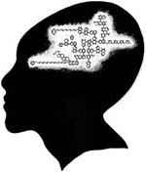
The Knowledge Yield Issue
90% of what you need to know is not written down, it is inside peoples heads (tacit knowledge)
90% of what is inside peoples heads they can’t tell you

Slide 23
Tacit Knowledge …
This is where the good stuff lies…. But how do you get at it?
“The future is already here, it is just not evenly distributed” -- William Gibson (science fiction author)

