Slide 1
Business
Design
Session 9
Business Design
Part I (voice-over only)
Dr. Tim Faley
University of the Virgin Islands
Tfaley@uvi.edu

Slide 2
Business Design
Business
Assessment
Operationalize Business
Business Design
Resource /
Due Diligence
The
ENTREPRENEURIAL
ARCH
Opportunity
Identification
Manage Growth
Capabilities
Business

Slide 3
Design before Testing and Building
Product development mantra: Design, Build, Test
Business Creation mantra: Design, Test, Build
Similar but slightly different
Businesses generally too expensive to build before testing in the market (although many still do it this way!)
Richard Bransons’s startup advice
Validate your business before launching it!
“Test” it!
See all 7 tips at:
https://www.virgin.com/richard-branson/how-give-your-business-best-chance-success-2017
Design
Test
Build
Design
Build
Test

Slide 4
Zooming in another level from OP ID
Who the business SERVES
Owner (who)
Society
Industry
Industry segment*
Customer
Motive (why)
Macro Driver
General Problem
Specific Issue
Need/Desire
Activity (what/how)
Opening
Capabilities
Approach
Offering/Action
Monetization
Potential to create value
Create value
H. Value / Capture value
Revenue model
Margin Assessment
Investability Analysis
Zooming In/Out
*or addressable market
End of Opportunity Identification
End of Business Design
Notes:
At the end of opportunity identification, you have not yet zoomed into to a specific customer or a specific solution; but rather to a issue and an approach to solving that issue.

Slide 5
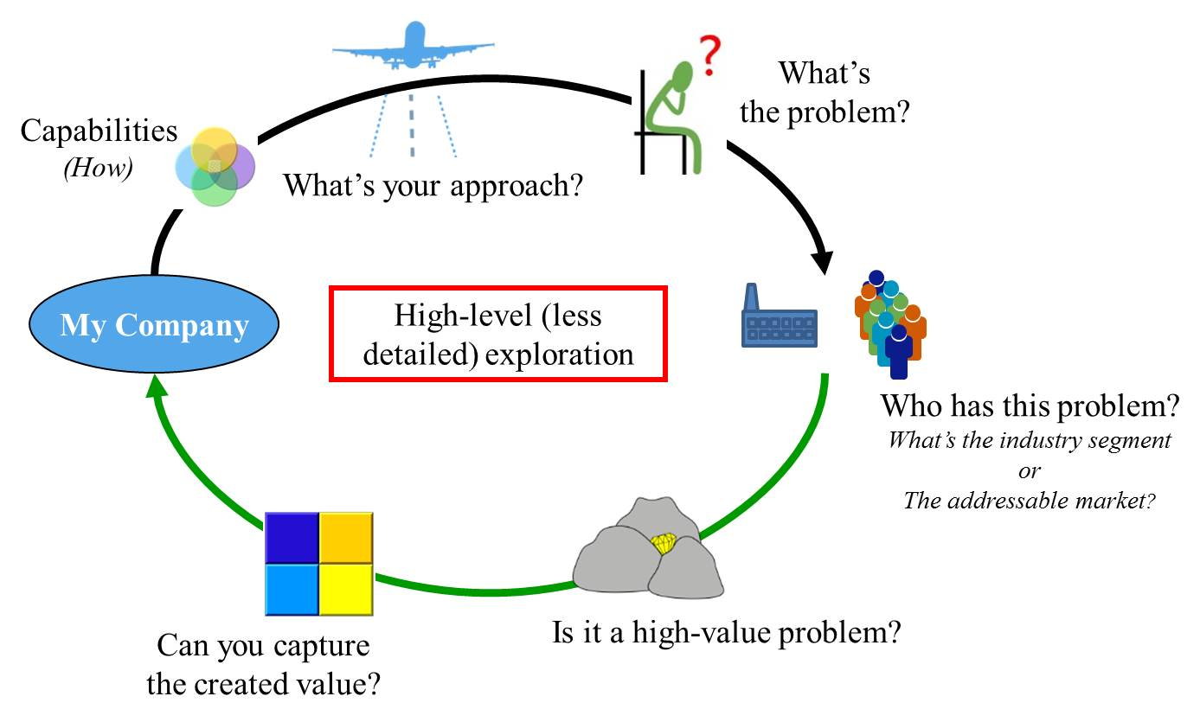
At the end of Opportunity Identification you know
Notes:
Zooming out from the qualitative description of the business produces a high-level (albeit less detailed) look. Zooming out widens the field of view while lessoning the amount of detail that can be observed. An approach to solving a problem is determined before a specific offering is detailed in the Business Design segment. The customer is not known in detail, but the industry segment or addressable market that has an identifiable problem is known a the end of this level.

Slide 6
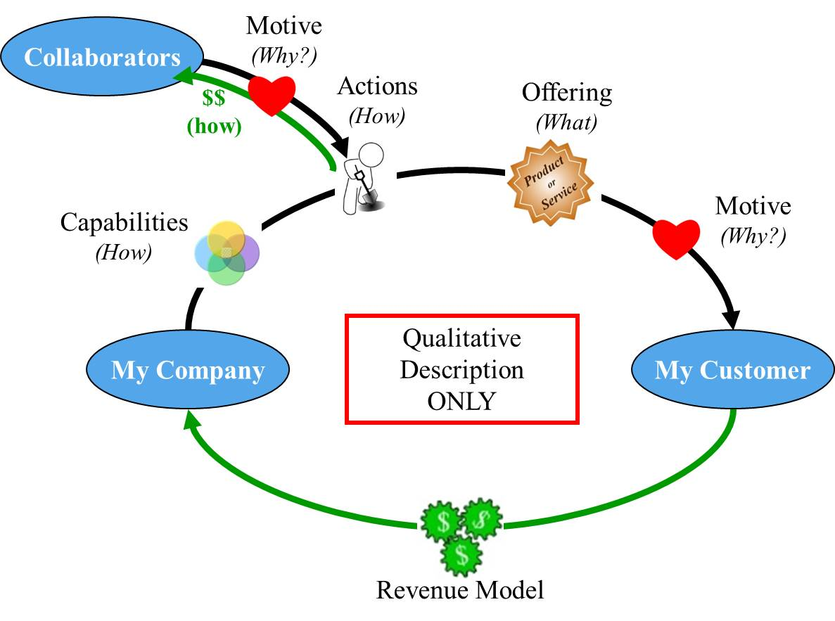
Business Design Output
(i.e. Need/Desire)
Notes:
This qualitative-only business description is not a complete business model. At the University of Michigan, we have call this qualitative-business model the “Business Construct.”

Slide 7
Business Design Output: Crafting a High-level Business Framework
Business Construct (ie Qualitative Business Model)
Activities (of the business)
Offering (product/service):
What precisely is your product/service?
Actions your firm takes:
What precisely does the company do?
How does this leverage your Capabilities?
What activities do you leverage from the existing ecosystem?
Monetization (method of the business)
How does your company make money (revenue model)?
Value capture mechanism?
Owner (of the problem) Group or Person that the business SERVES
Who (very specifically) are your customers and collaborators?
What is your target persona? (Need-based market segment?)
Motive (of the problem owner)
Why do your customers/collaborators buy your product / collaborate with you?
What value do you create/problem do you solve for the your customer and collaborator?
How does your offering compare to existing solution?
Business Perspective
Customer Perspective
Notes:
The “business construct” is the qualitative view of the business model. Not quite a business model, since it does not contain the quantitative parts (margins, investment). Clearly articulating and assessing the qualitative before jumping into and assessing the quantitative helps avoid getting ‘lost in the numbers.’

Slide 8
Position Statement for Customer
Clearly articulated positioning statement
For … (target segment / persona)
The … (product / service)
Satisfies… (most important user need)
By delivering... (key benefit or feature)
Through/via/created by our… (underlying capability)
Example
For the small or home-based business owners
Symantec Endpoint Protection Small Business Edition
Prevents cybercriminals from accessing and destroying your vital business information
By protecting your computers and servers
Through seamless, user-transparent updating of your machines with the most current antivirus, anti-malware technology updates
Notes:
Clear and precise position statements can also be written at this stage. Both for customer and collaborators (see next slide)

Slide 9
Common Mistakes at this phase
Assume venture will do everything related to the creation of the venture’s advantaged product and delivery of that product to the customer
Really? How big a firm are you?
Must narrow to core competencies
Confuse Customers and Users
Both are important, but typically only capture value from one
Do not understand the true needs of customers, try to address “everyone”
Never drill down past “market segment” – Opportunity Identification level
If you cannot describe them specifically, how can you count them? In the next step (assessment) you will be asked “how many” customers. If don’t know who they are (very specifically), you cannot answer that question.

Slide 10
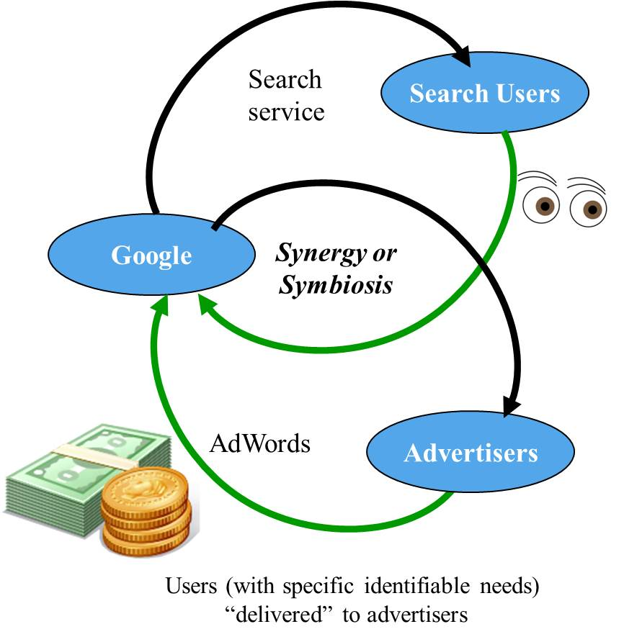
Multi-platform Business (ex. Google)
No/little Revenue from
USERS
CUSTOMERS PAY

Slide 11
Common Mistakes at this phase
Assume venture will do everything related to the creation of the venture’s advantaged product and delivery of that product to the customer
Really? How big a firm are you?
Must narrow to core competencies
Confuse Customers and Users
Both are important, but typically only capture value from one
Do not understand the true needs of customers, try to address “everyone”
Never drill down past “market segment” – Opportunity Identification level
If you cannot describe them specifically, how can you count them? In the next step (assessment) you will be asked “how many” customers. If don’t know who they are (very specifically), you cannot answer that question.

Slide 12
At the End of Business Design
Who the business SERVES
Motive
Macro Driver
General Problem
Specific Issue
Need/Desire
Owner
Society
Industry
Industry segment
Customer
Monetize
Potential value creation
Create value
H. Value / Capture value
Revenue model
Margin Assessment
Investability Analysis
Owner
Society
Industry
Industry segment
Customer
Activity
Opening
Capabilities
Method
Offering/Actions
Zooming In
Business Design

Slide 13
One way to accomplish this….

Slide 14
Business Design Methodology (1/5)
Step 1. Diagnose
OWNER CUSTOMER/MOTIVE: Customer/Needs discovery
Zoom in and identify underlying needs that follow from the Specific Issue
Perform industry/market segment elicitations to find underlying causes
Zoom in “What’s causing this?” “What’s going on?”
Zoom out “why do we care about this?”
Determine customer’s underlying needs
Perform customer elicitations to uncover their root-cause needs
It is very likely that you will discover many customer/need pairings.
Choose a pair (customer/need) that best aligns with your Capabilities and with the Specific Issue (i.e. is a high value opportunity)
If none (or none left to assess) return to Opportunity Identification

Slide 15
Directed Discovery: Finding the root-cause
What Causes this? What’s going on?
Root-cause need
What Causes this? What’s going on?
What Causes this?
What’s going on?
Symptom
Underlying problem
Specific Issue
What→who→elicitation→what →who→elicitation… repeat until uncover root-issue its owner.

Slide 16
Knowledge….
Two classes of knowledge:
Tacit
We know, but cannot explain
Explicit
Books, journals, lecture notes, etc.
In other words, things we can “google”
Goto Knowledge slide for more details (slide 45 of non-voiceover deck; Part 2, slide 13 of voiceover deck)

Slide 17
Getting from Conjecture to Reality Which column?
Thing we want to know
Things we think we know.
Belief or data supported?
Thing we know
Data supported
…
…
Goal is to move things this way
<<“Getting Rid of Luck” clip>>

Slide 18
Elicitations: How to get information people have in their heads that they don’t even know is there? (tacit knowledge)
For Details, see Appendix B of textbook
Listen to “Think Like a Traveler” video clip

Slide 19
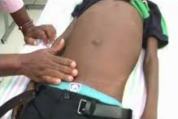
This is DIAGNOSIS Find something tender before drilling deeper..
Use virtual observation to tell their story
Listen (active listening, not just words, see next slide)
Once find something of interest (tender – usually emotive response – lean forward, pace of talk quickens, etc.)
Notes:
Cannot be done with a survey. Must be a CONVERSATION

Slide 20
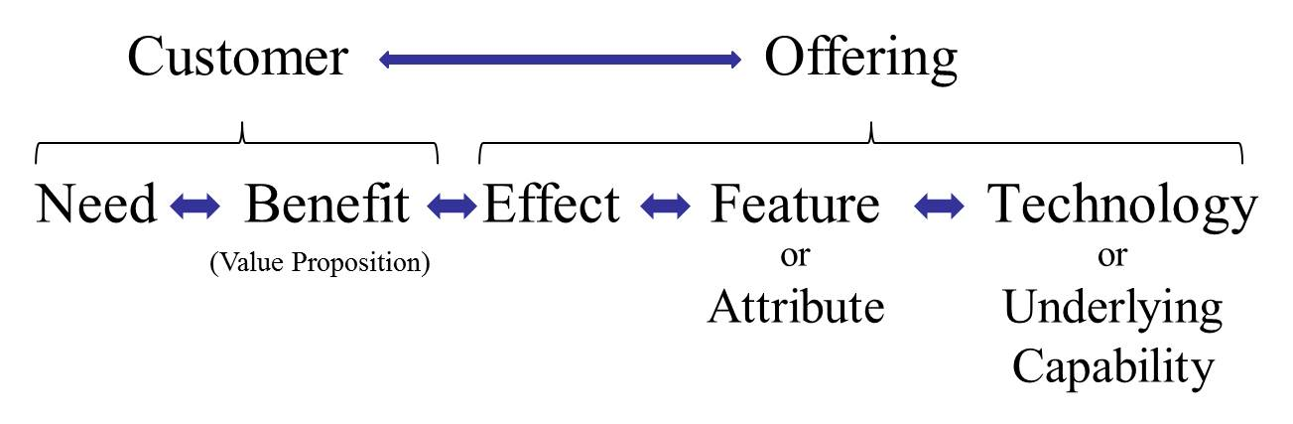
Business Design Methodology (2/5)
Step 2. Prescribe (don’t prescribe, until you’ve diagnosed!)
ACTIVITY (1): Create an offering that would satisfy that need (this is creative work; again divergent & convergent)
Follow logic flow backwards: from need/benefit/effect/product attribute
Create story board to articulate concept (if it helps)
Perform more elicitations to validate hypotheses as needed
Identify offering that would have highest adoption rate potential
Create an offering position statement

Slide 21
Finding the real issue gets you half-way
Now you need a SOLUTION that connects with Identified Problem

Slide 22
Offering Design
Discover (research / divergent thinking)
How does the customer cope now?
What alternatives exist today in the market?
Why are these ‘unsatisfactory’ (in the mind of your customer)?
Develop (convergent thinking)
What could you offer that is different?
How would you create it?
What other resources/firms would you need?
Who specifically are you offering this too?
Who is your target market?

Slide 23
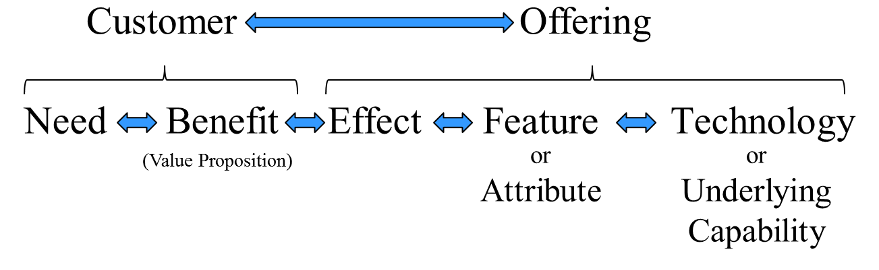
Customer ←→ Offering
Illustrates the connections
What value proposition does your offering create for the customer?
What is the offering attribute that creates this effect?

Slide 24
Customer Needs
Cannot satisfy ALL customer needs
Being all things to all people is being nothing to no one
Start as simple as possible, add complexity as you grow business
Three categories of customer need
Required needs
Must have to be considered a viable customer alternative (to be considered a car, it must transport people and things from point A to point B)
Ignored needs
Needs of some market segments that you are consciously choosing to ignore (Walmart ignores luxury needs)
Differential needs
Customer needs that you are focusing on satisfying that differentiates you from the competition

Slide 25
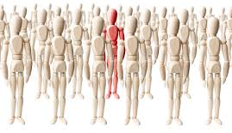
Marketing is targeting
Describe your target market
Identifying, selecting, describing and quantifying your customer, your market segment, your audience
No organization has enough resources to be everything to everyone

Slide 26
Market Segmentation
Segment the Market
What is your initial target segment?
Initial target customer?

Slide 27
EVERYONE = NO ONE
Copyright © 2014 by Timothy L. Faley

Slide 28
10% of EVERYONE = 10% of NO ONE
Corollary….
Copyright © 2014 by Timothy L. Faley

Slide 29
Position Statement for Customer
Clearly articulated positioning statement
For … (target segment / persona)
The … (product / service)
Satisfies… (most important user need)
By delivering... (key benefit or feature)
Through/via/created by our… (underlying capability)
Example
For the small or home-based business owners
Symantec Endpoint Protection Small Business Edition
Prevents cybercriminals from accessing and destroying your vital business information
By protecting your computers and servers
Through seamless, user-transparent updating of your machines with the most current antivirus, anti-malware technology updates

Slide 30
Natural System Tension
Whole Product that directly satisfies the entire critical issue (maximum value creation)
Minimizes complementary products
Widest range of activities/capabilities necessary
Directly address need/ value generation site
Narrow Offering that is produced solely from differentiated capabilities (optimal value capture)
Most specific, potentially most differentiated offering
Minimal activities performed in-house, most aligned with core capabilities
Potentially far from value generation site

Slide 31
PVC Test to see if you can compete by offering this solution…. If not, pivot
See Opportunity Identification slides and Appendix A of textbook
for review of details

Slide 32
End of Part 1 of Business Design (Voiceover slide deck only) Pick up on the Business Design Methodology in the Part 2 Deck

