Slide 1
MGT 213:
Small
Business
Management
How to Use a 2x2 Matrix
Dr. Tim Faley
University of the Virgin Islands
TFaley@uvi.edu
September 2018

Slide 2
2x2 ‘s
Powerful and Diverse Tool
Many types
All are used the same way
Used to Help Categorize items
-- OR --
Evaluate something

Slide 3
2x2 Requires 3rd Level Learning Strategy

Slide 4
How to Read a 2x2
All 2x2 are used the same way:
All require the use of a 3-step sequence (or process)
If you learn how to read ONE, you can read all of them
Criteria 1 and Criteria 2 are INDEPENDENT of each other (must be evaluated separately)
Low High
(Small) (Big)
Criteria 2
Low High
(Small) (Big)
Criteria 1

Slide 5
How to Read a 2x2
Three-Step Process:
Choose the appropriate Column
(based on the Column criteria)
Choose the appropriate Row
(based on the Row criteria)
The intersection is the Conclusion
Conclusion
1
Low High
(Small) (Big)
Criteria 2
Low High
(Small) (Big)
Criteria 1

Slide 6
How to Read a 2x2
Three-Step Process:
Choose the appropriate Column
(based on the Column criteria)
Choose the appropriate Row
(based on the Row criteria)
The intersection is the Conclusion
Low High
(Small) ( Big)
Criteria 2
Conclusion
4
Low High
(Small) (Big)
Criteria 1

Slide 7
How to Read a 2x2
Conclusion
2
Conclusion
1
Low High
(Small) (Big)
Criteria 2
Conclusion
4
Conclusion
3
Low High
(Small) (Big)
Criteria 1

Slide 8
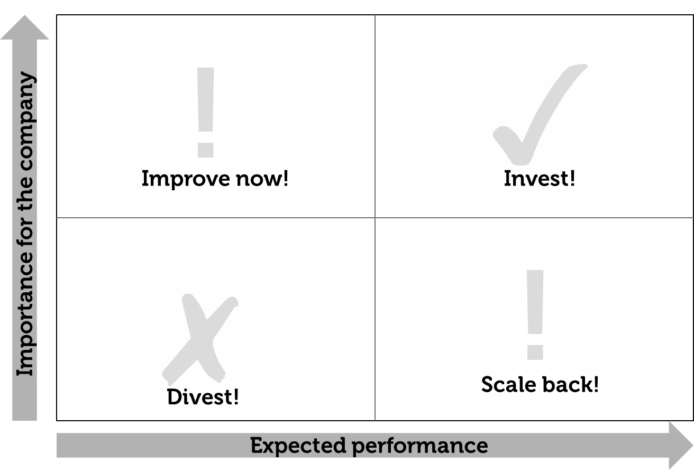
Should the Company Invest?
(High)
(Low)
(Low)
(High)

Slide 9
Should the Company Invest?
(High)
(Low)
(Low)
(High)

Slide 10
Classic Marketing Matrix

