Slide 1
Session 8:
Opportunity
Identification:
Part II
Session 8, Part II:
Step 1 in Creating Your New Business:
Identify the Opportunity
Dr. Tim Faley
TFaley@uvi.edu

Slide 2
Brainstorming while Zooming In
Potential Solution
Approaches
General Problem
Specific Issue
Macro Issue
… leads to more diverse ideas

Slide 3
Is this progress?
Now you have LOTS of ideas, not just one…
Need to screen those that are not viable…
This is the CONVERGENT thinking part
In this part we will talk about how to do the
CONERGENT
Thinking Steps in Business Opportunity Identification

Slide 4
CONVERGE on the Solution Space
First Organize, then Converge.

Slide 5
Business Discovery Steps
Opening (why now?)
7 Sources of Innovation
Potential for you to create value
Opening and alignment with your capabilities
Is this a high-value problem ?
Industry Analysis
Potential to capture value (for the solution approach you’re taking)
Strategy, Position for Value Capture (PVC)
Investable
Will it be worth more than it costs to build?

Slide 6
Business Discovery Steps
Opening (why now?)
7 Sources of Innovation
Potential for you to create value
Opening and alignment with your capabilities
Is this a high-value problem ?
Industry Analysis
Potential to capture value (for the solution approach you’re taking)
Strategy, Position for Value Capture (PVC)
Investable
Will it be worth more than it costs to build?

Slide 7
Disruption Drivers: Drucker’s 7 Sources on Innovation
Unexpected Occurrences
Believed the drug would reduce blood pressure, and it grew hair!
Incongruities
“Health care” is really about disease mitigation
Process Needs
Industry and Market Changes
Internet businesses changing the traditional retail landscape
Demographic Changes
Aging Baby Boomers are driving many healthcare/product changes
Changes in Perception
Attitude shifts, such as earth’s resources may not be infinite, influencing the “green” products revolution
New Knowledge
New technology enable new products (iPad)
Copyright © 2017 by Timothy L. Faley
Ref. Innovation and Entrepreneurship, Peter Drucker, 1985.

Slide 8
Business Discovery Steps
Opening
7 Sources of Innovation
Potential for you to create value
Opening and alignment with your capabilities
Is this a high-value problem ?
Industry Analysis
Potential to capture value
Strategy, Position for Value Capture (PVC)
Investable
Will it be worth more than it costs to build?

Slide 9
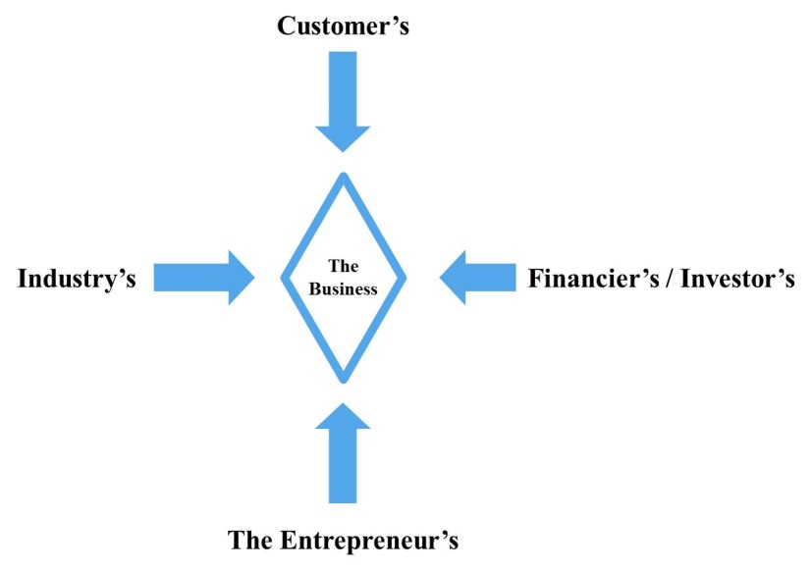
Four Points-of-View of a New Business
Can YOU do this?
Notes:
Fallacy that you can simply hire someone to do the business for you. You cannot afford that! Besides, if you don’t bring anything to the table, the people that you hired to run your business will take over the business and fire you – (most likely quit and start a competitive business that puts yours out of business).

Slide 10
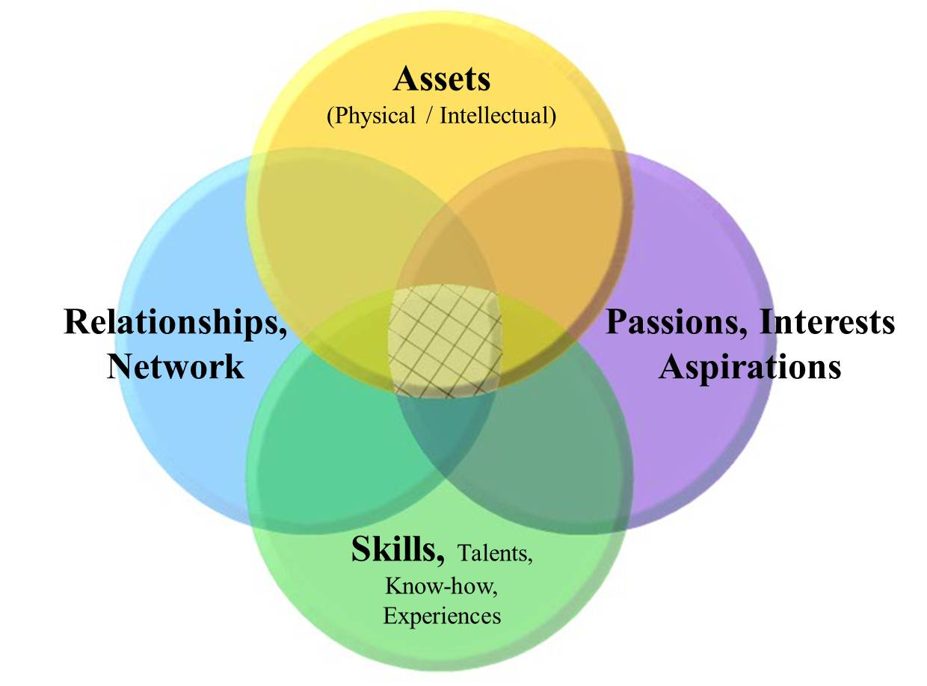
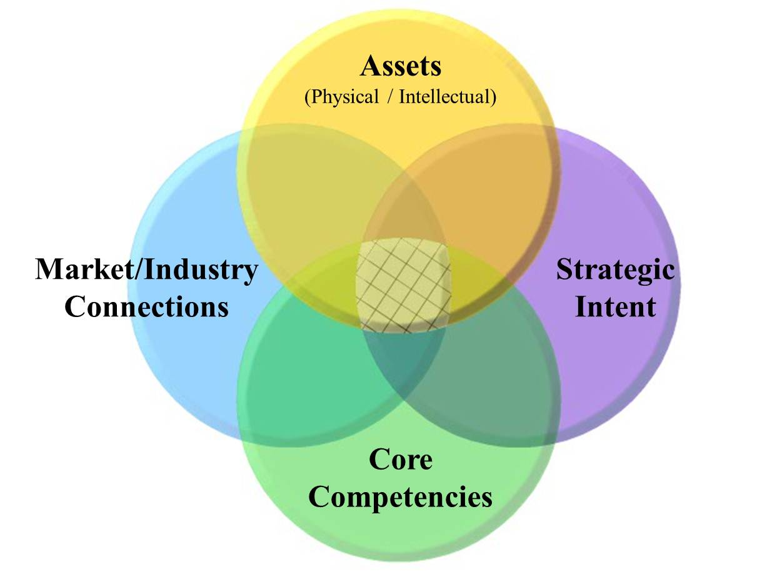
Capability Map
Team Capability Map
Corporate Capability Map

Slide 11
Business Discovery Steps
Opening
7 Sources of Innovation
Potential for you to create value
Opening and alignment with your capabilities
Is this a high-value problem ?
Industry Analysis
Potential to capture value
Strategy, Position for Value Capture (PVC)
Investable
Will it be worth more than it costs to build?

Slide 12
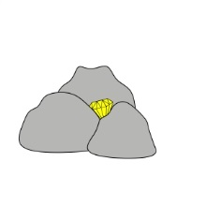
High-value Problem?
“Diamond in the rough?”
Notes:
Is this problem a real “big deal”? We all have many things we’d like taken care of for us, or fixed in some way. But we are not willing to pay for the small ones – easier just to continue to live with them.

Slide 13
What is Value? What is valuable?

Slide 14
How do you measure value?
Money
Time
Ease of use
Style
Status (perception)
Intrinsic
and more …

Slide 15
Relativity
In contract negotiations:
BATNA
Best Alternative To a Negotiated Agreement
You will never get someone to agree to a contract term that is of less value than they can get without a negotiation
Example if you are negotiating for a raise; the fall-back position or BATNA is to stay at your current pay. The possibility of reducing your salary in the new contract is not possible as it is less than your BATNA.
In negotiating anything you must ALWAYS know the BATNA of the person with whom you are negotiating

Slide 16
Relativity… continued
High-value problem
How frequently do they deal with this problem?
Must always know the problem-owner’s BATNO
Best Alternative To a New (solution) Option
How do they manage now?
What is the specific issue that the current solution addresses?
What are the advantages/disadvantages of the current solution?
How frequently do they have to deal with this issue?

Slide 17
What’s the Specific Issue
What do people do now?
This is the answer, you need to find out what the question is!
Discover that question, zoom out to a more general issue, THEN, you can brainstorm on other potential solutions in addition to determining that general issue’s value

Slide 18
Business Model Discovery
Who the business SERVES
Motive
Macro Driver
General Problem
Specific Issue
Need/Desire
Owner
Society
Industry
Industry segment
Customer
Monetize
Potential value creation
Create value
H. Value / Capture value
Revenue model
Margin Assessment
Investability Analysis
Owner
Society
Industry
Industry segment*
Customer (target segment)
Act
Opening
Capabilities
Approach
Offering/Activities
Zooming In/Out
Directed Discover Starting Point
* Or Addressable Market
Opportunity Identification

Slide 19
Uncovering relative value. Advantages / Disadvantages of Current Solutions
Advantages
Disadvantages
Familiarity
..
…
Cost?
Why?
Time?
Why?

Slide 20
Getting from Conjecture to Reality Which column?
Thing we want to know
Things we think we know.
Belief or data supported?
Thing we know
Data supported
…
…
Goal is to move things this way

Slide 21
Business Discovery Steps
Opening
7 Sources of Innovation
Potential for you to create value
Opening and alignment with your capabilities
Is this a high-value problem ?
Industry Analysis
Potential to capture value (dependent on your approach)
Strategy, Position for Value Capture (PVC)
Investable
Will it be worth more than it costs to build?

Slide 22
Four Points-of-View of a New Business
How does your business interact with the greater industry ecosystem?

Slide 23
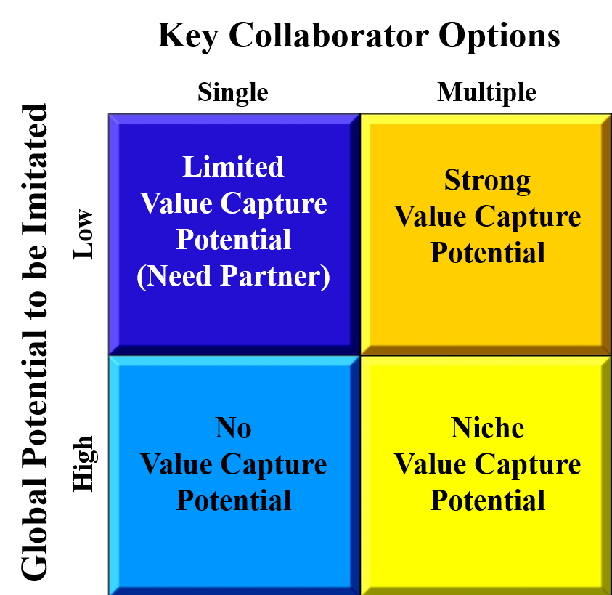
Potential for Value Capture (PVC):
Collaborators to your business include:
Suppliers
Distributors
Shippers
Stores that sell your product
Etc.
Service Providers
Attorney
Advertiser
Tax Preparer
Etc.
Detailed Description slide 34 of this deck

Slide 24
Business Discovery Steps
Opening
7 Sources of Innovation
Potential for you to create value
Opening and alignment with your capabilities
Is this a high-value problem ?
Industry Analysis
Potential to capture value
Strategy, Position for Value Capture (PVC)
Investable (this is assessment; more on this later)
Will it be worth more than it costs to build?

Slide 25
Four Points-of-View of a New Business
What is the firm’s investment return potential?

Slide 26
Business Discovery Steps
Opening
7 Sources of Innovation
Potential for you to create value
Opening and alignment with your capabilities
Is this a high-value problem ?
Industry Analysis
Potential to capture value
Strategy, Position for Value Capture (PVC)
Investable (this is assessment; more on this later)
Will it be worth more than it costs to build?

Slide 27
Investment Potential – Deal with this in Assessment
Copyright © 2014 by Timothy L. Faley

Slide 28
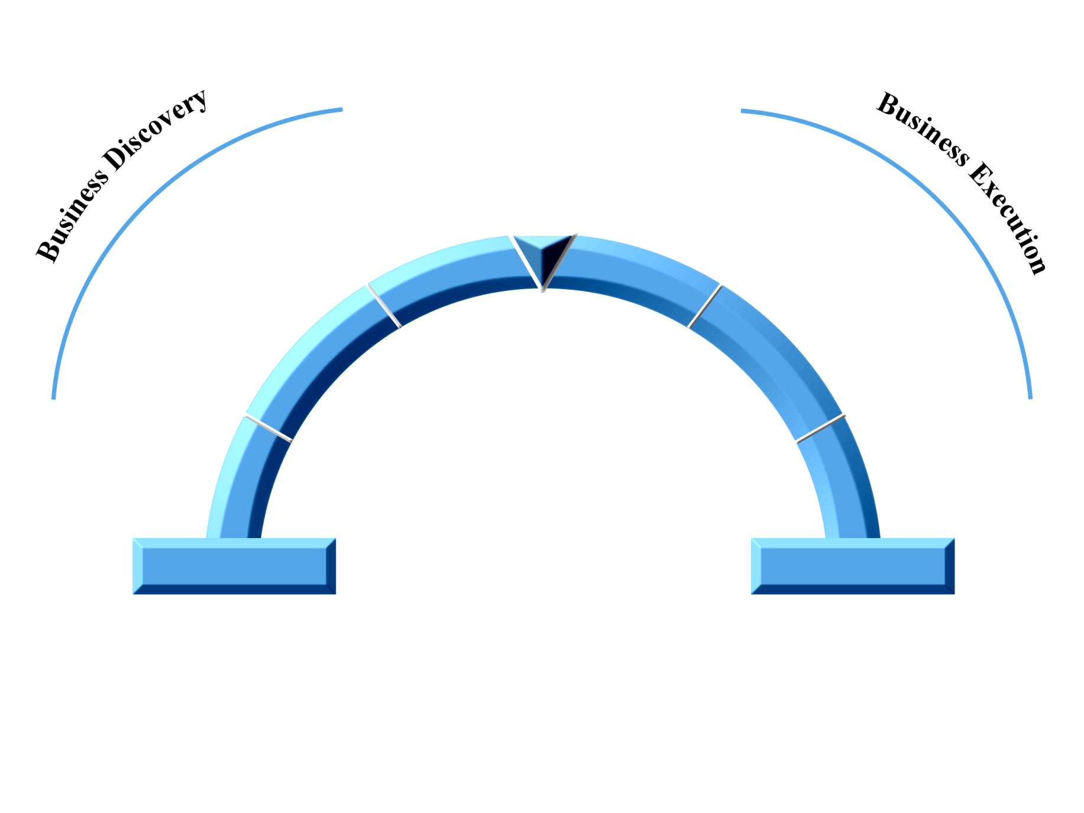
Two halves: Discovery and Execution
Business
Assessment
Operationalize Business
Business Design
Resource /
Due Diligence
The
Entrepreneurial
Arch
Opportunity
Identification
Manage Growth
Capabilities
Business
Skills/Talents
Assets (physical/Intellectual)
Networks/Relationships
Interests/Passions/Aspirations
Copyright © 2012 by Timothy L. Faley

Slide 29
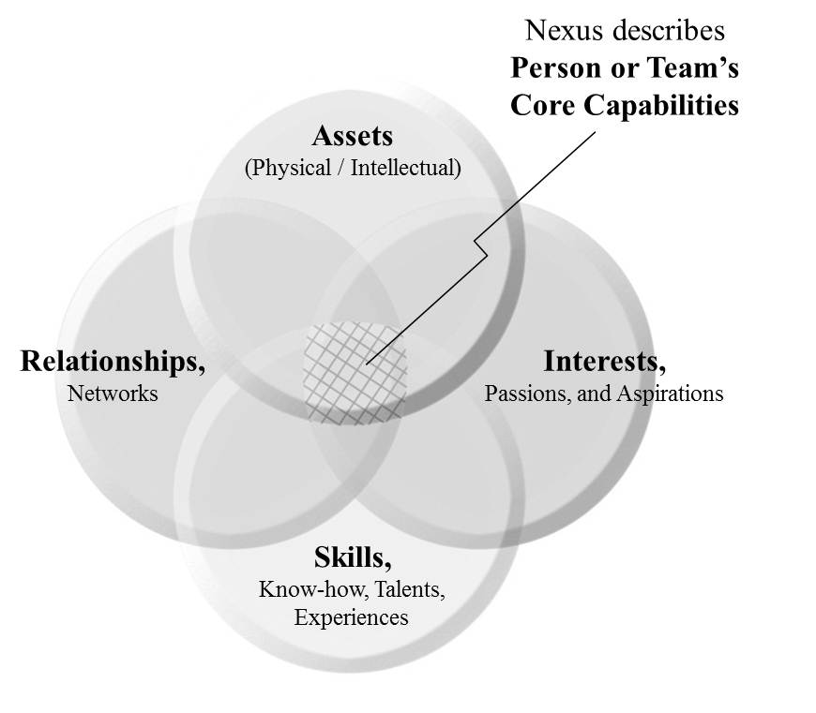
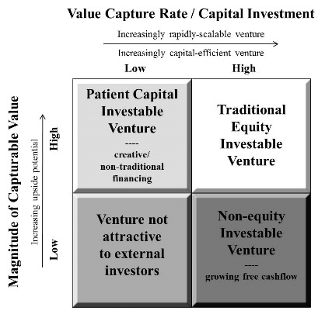
Business Discovery Steps
Innovation Sources:
Unexpected Occurrences
Incongruities
Process Needs
Industry & Market Changes
Demographic Changes
Changes in Perception
New Knowledge
Opening (why now?)
Timing Right?: Check 7 Sources of Innovation
Potential for you to create value
Opening and alignment with your capabilities?
Is this a problem worth solving?
(BATNO – Best Alternative to New Option)
Potential to capture value (specific to an approach)
Strategy, Industry Analysis, Position for Value Capture (PVC)
Investable (addressed in Feasibility Study)
Will it be worth more than it costs to build?

Slide 30
At the End of Opportunity Identification

Slide 31
Opportunity Identification Output: Qualitative aspects of the Business Model
Business Concept
Owner (of the problem) Person or Group your business SERVES
In what segment of what industry (or addressable market) is this an issue?
Motive (of the problem-owner to change)
What is the specific issue you are trying to address?
Activity (by business)
What is your approach to addressing this issue?
Which (or what combination) of the 5 ways to create value are you exploiting?
Monetization (by the business)
How do you know this is a high-value problem?
Given the approach, are you in a position to capture any of the created value? (PVC)

Slide 32
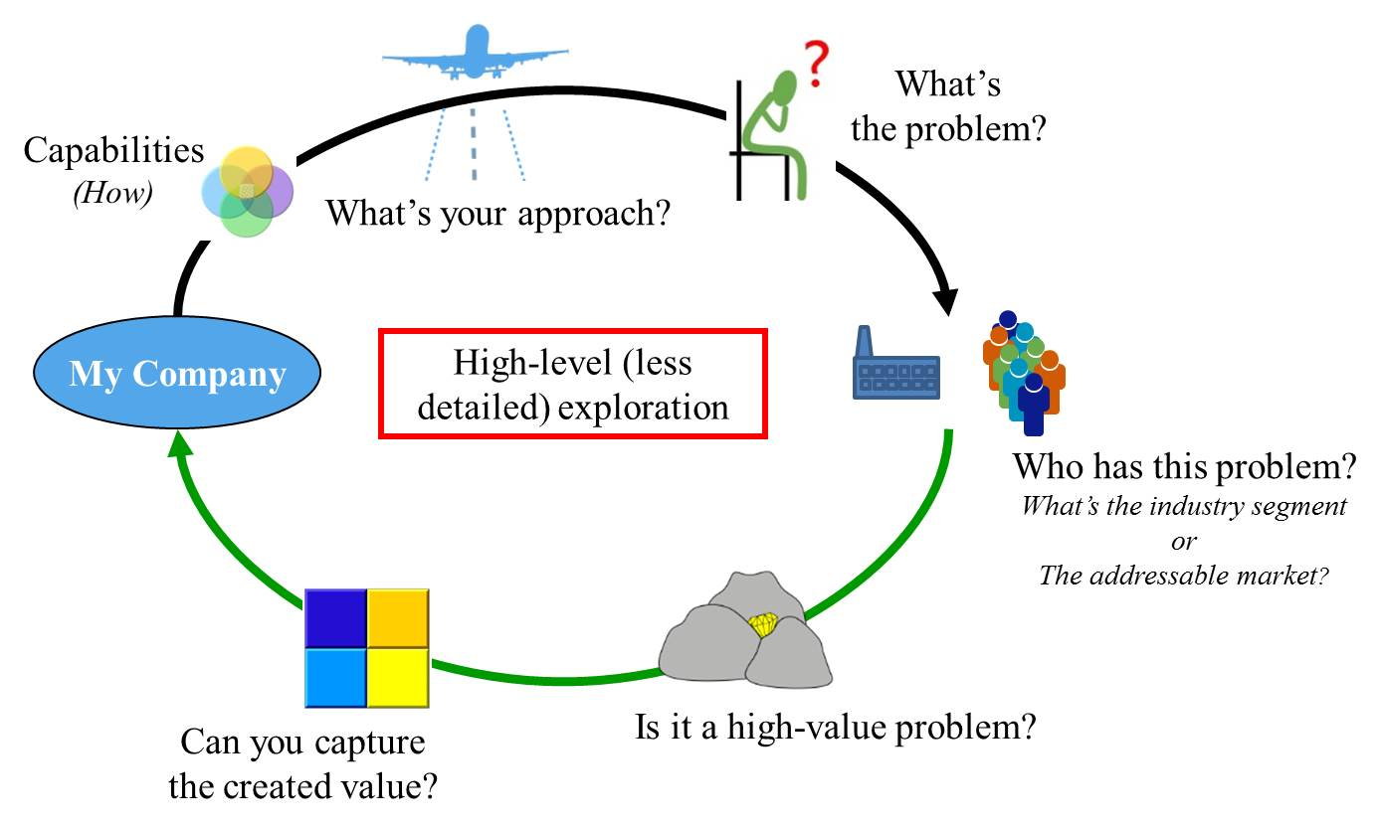
At the end of Opportunity Identification you know

Slide 33
Quiz For Session 08
Take Quiz 4
See syllabus for details

Slide 34
PVC Details

Slide 35
Objective of PVC Analysis
Understand Ability to Capture Value that business creates for the customer
Every business has “collaborators”
Yes, the customer $$ come in the “front door” to our business, but do they simply pass through the “back door” to our “collaborators”?
We do not want to create a business that enriches our collaborators, we want to retain a significant portion of the value we create
The PVC gives us a qualitative means to assess whether or not we can capture value

Slide 36
Potential for Value Capture (PVC): Can your business capture most of the value it creates?
Collaborators to your business include:
Suppliers
Distributors
Shippers
Stores that sell your product
Etc.
Service Providers
Attorney
Advertiser
Tax Preparer
Etc.
Ref: Based on David Teece’s framework, 1986

Slide 37
Assess which Row your business would be in
Would take a long time or
Lots of money for someone else
to replicate your product/service
Others could replicate your product/service fairly easily in a relative short amount of time
May or may not be difficult LOCALLY, but possible GLOBALLY

Slide 38
List your collaborators
What are all the things that your businesses needs to do to create and deliver your product/serice to your customer?
Categorize these things (These are your Key Collaborators):
Advertise
Make the product
Obtain raw materials
Ship the product
How may potential companies can do each category for you? Many or just One?

Slide 39
Assess which Column your business would be in
Few or Limited suppliers
For each category of collaborator
Many supplier choices

Slide 40
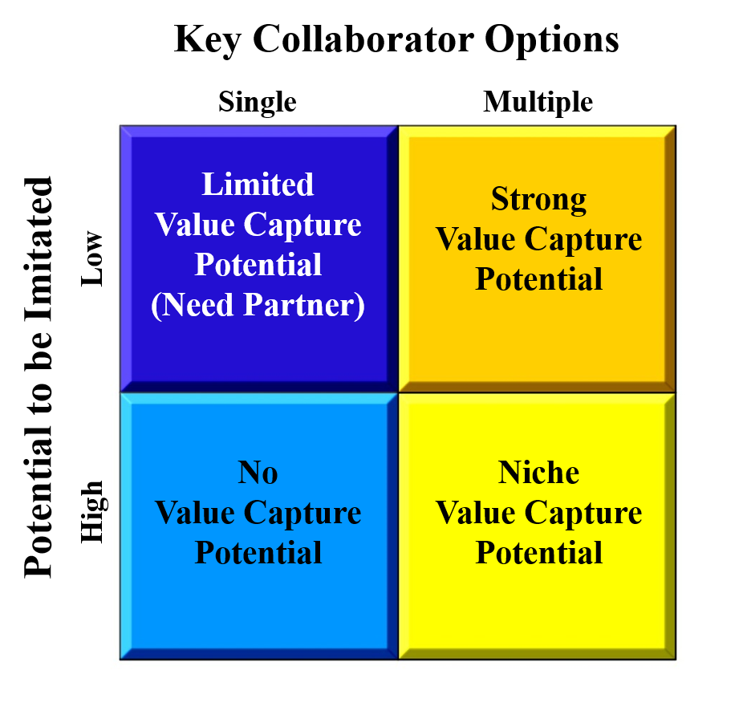
Conclusion is a specific quadrant
Business in this quadrant has potential to be GLOBALLY COMPETITIVE
This business has the potential to be
LOCALLY COMPETITIVE
(i.e. good small business)
X

Slide 41
Quiz For Session 08
Take Quiz 4
See syllabus for details of timing

