Slide 1
Session 8:
Opportunity
Identification:
Part I
Session 8, Part I:
Step 1 in Creating Your New Business:
Identify the Opportunity
Dr. Tim Faley
TFaley@uvi.edu

Slide 2
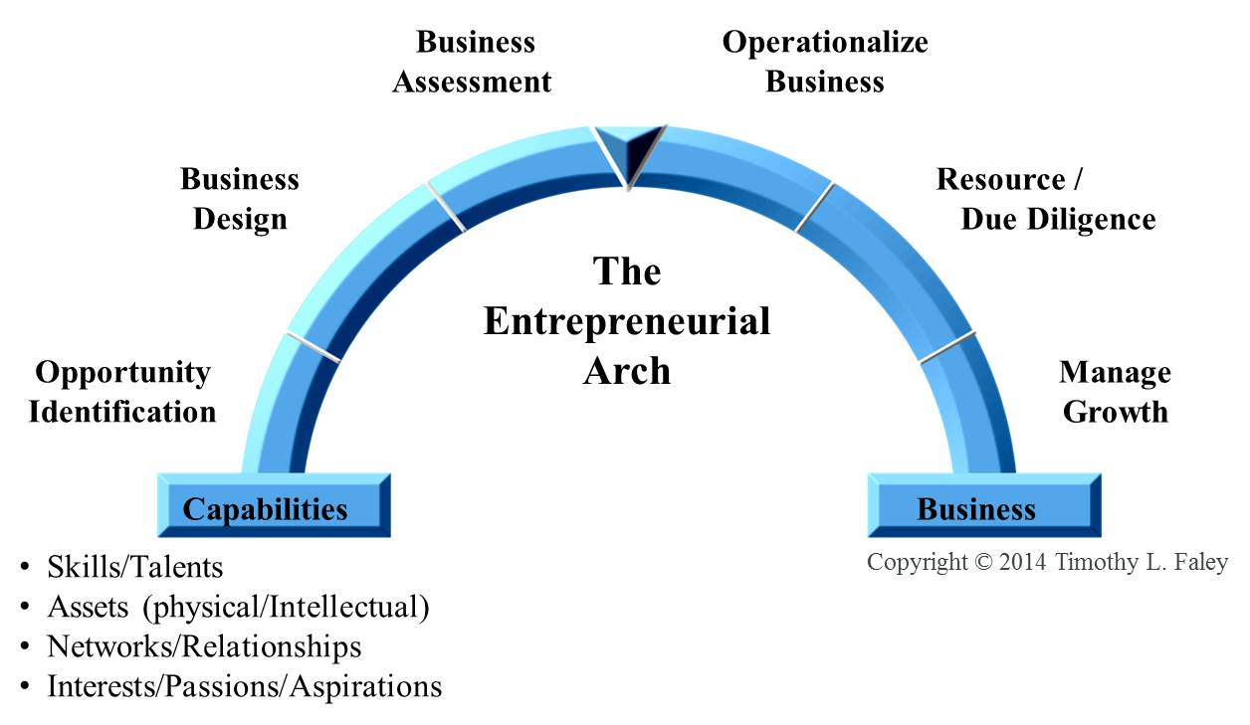
Entrepreneurial Arch

Slide 3
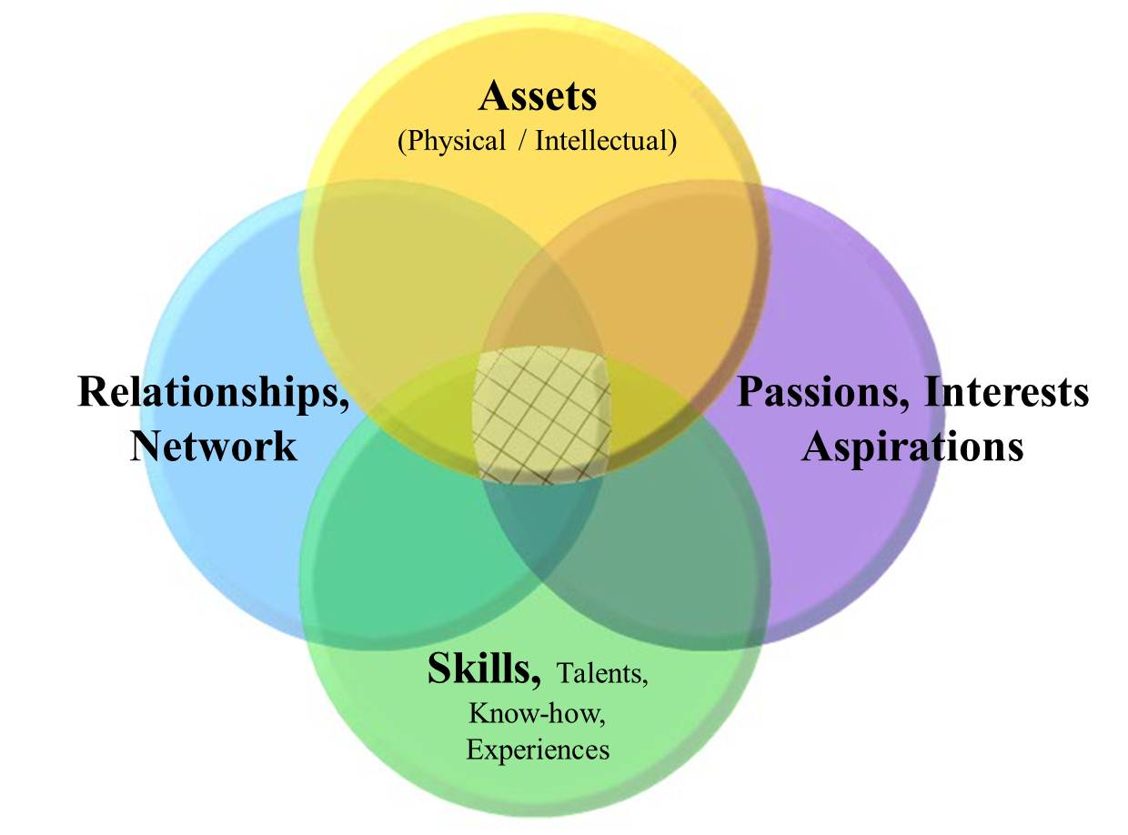
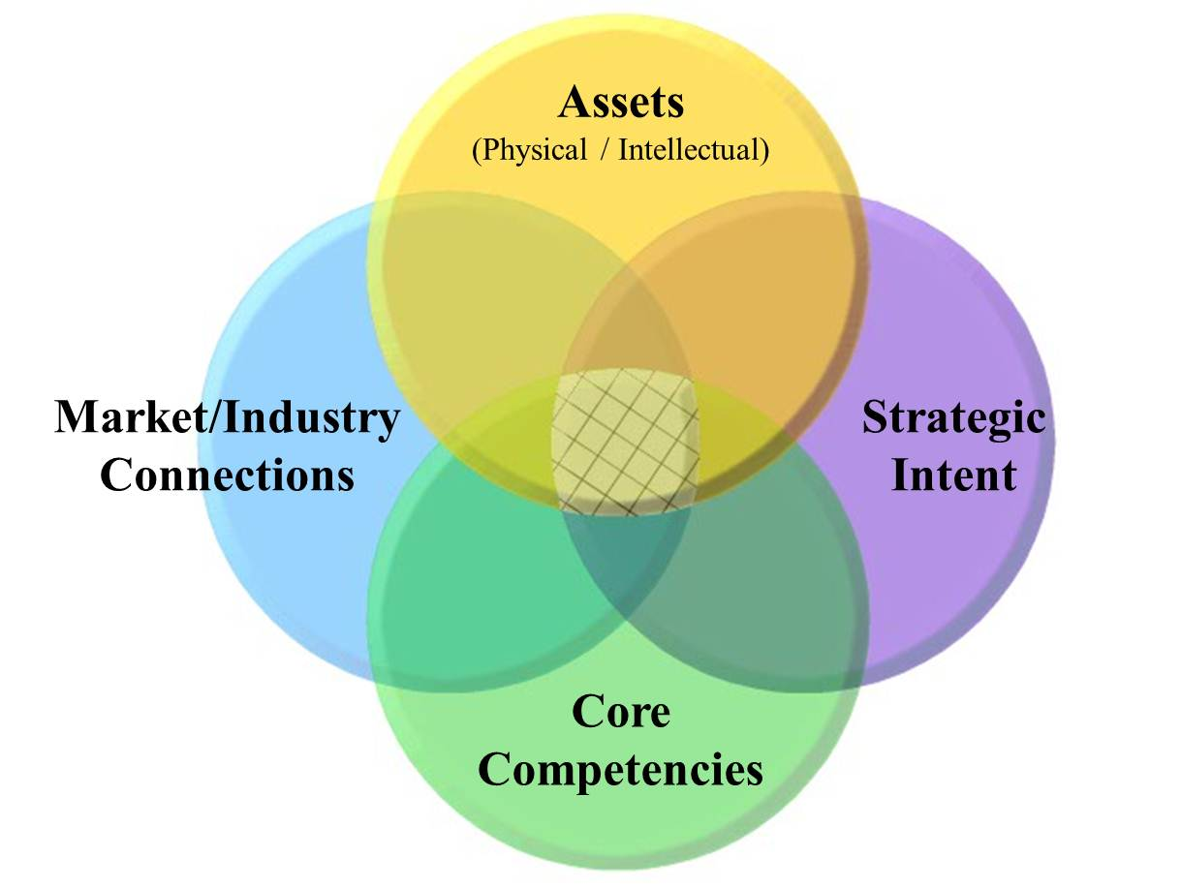
Capability Map
Team Capability Map
Corporate Capability Map

Slide 4
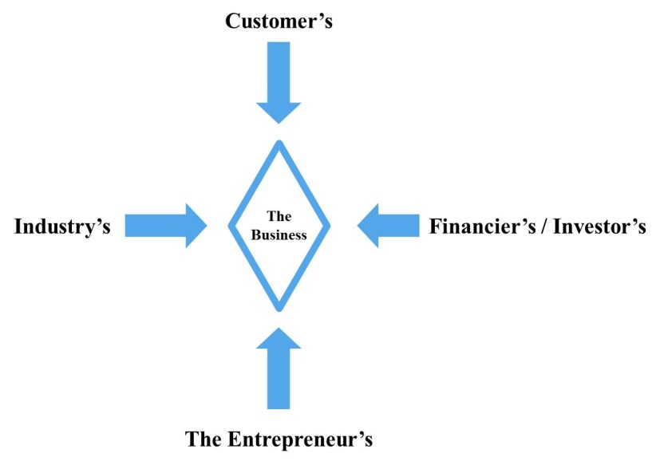
Business Rule of 4s
Every Business Needs 4 components
Person or group that the business SERVES (book says “owner” of the problem the business addresses)
Motivation to change (what problem are you trying to solve)
Activity (what will you do about the issue?)
Monetization (how will you make money doing this?)
Every business has 4 Points-of-View
Customer
Perspective
Business
Perspective

Slide 5
Every Business Model: 4 components or pillars Each pillar has four distinct layers
Who the business SERVES
Motive
Macro Driver
General Problem
Specific Issue
Need/Desire
Owner
Society
Industry
Industry segment
Customer
Monetization
Potential value creation
Create value
H. Value / Capture value
Revenue model
Margin Assessment
Investability Analysis
Owner
Society
Industry
Industry segment*
Customer
Activity
Opening
Capabilities
Approach
Offering/Actions
Zooming In/Out
* Or addressable market

Slide 6
Business Model Discovery via Levels
Who the business SERVES
Motive
Macro Driver
General Problem
Specific Issue
Need/Desire
Owner
Society
Industry
Industry segment
Customer
Monetize
Potential value creation
Create value
H. Value / Capture value
Revenue model
Margin Assessment
Investability Analysis
Owner
Society
Industry
Industry segment*
Customer
Act
Opening
Capabilities
Approach
Offering/Activities
Zooming In/Out
Quantify
Directed Discovery Starting Point
Opportunity Identification
Business Design
Assessment
* or Addressable Market

Slide 7
Business Discovery is very iterative
It is a hypothesis-directed discovery/learning process
What you learn in a subsequent stage changes your position in the prior
Move quickly – don’t fall in love with your first idea
Requires constant “zooming-in and zooming-out”
Taking both a narrow, detailed view and broad, “big picture” perspective
Business
Assessment
Operationalize Business
Business Design
Resource /
Due Diligence
The
ENTREPRENEURIAL
ARCH
Opportunity
Identification
Manage Growth
Capabilities
Business

Slide 8
Business Discovery Side of the Arch
Who the business SERVES
Motive
Macro Driver
General Problem
Specific Issue
Need/Desire
Owner
Society
Industry
Industry segment
Customer
Activities
Opening
Capabilities
Approach
Offering/Actions
Monetization
Potential for value creation
Create Value
H. Value / Capture value
Revenue model
Margin Assessment
Investability Analysis
Zooming In/Out
Complete
Business Model
Offering
Business Construct
(Qualitative Business Model)
Offering Concept
Business Plan
Go to market strategy
Business
Assessment
Operationalize Business
Business Concept
Solution Approach
Business Design
Resource /
Due Diligence
The
Entrepreneurial
Arch
Opportunity
Identification
Manage Growth
Capabilities
Business
Copyright © 2015 by Timothy L. Faley

Slide 9
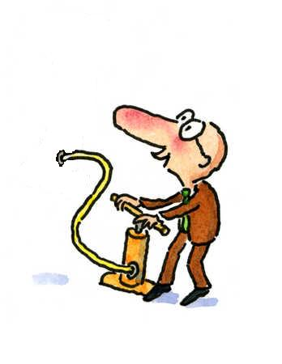
Opportunity Drivers: Seeds of Innovative New Ventures
Discontinuities
Environmental Schisms
New Laws
New Problems
New Solutions
Inflated by:
Innovation Sources *:
Unexpected Occurrences
Incongruities
Process Needs
Industry & Market Changes
Demographic Changes
Changes in Perception
New Knowledge
All new innovative businesses are a function of time; created by disruptions/innovations.
* Sources from Peter Drucker’s Innovation and Entrepreneurship (1985)
Copyright © 2015 by Timothy L. Faley

Slide 10
Discovering New Businesses
Randomly coming up with ideas and screening them (Ideation and Filtration, i.e. spaghetti against the wall) is a low probability exercise (3000 to 10,000:1).
Since we individually and corporately tend to think in terms of specific activities or product ideas, we need to understand how to broaden and reshape our initial concepts, not simply cull them
Zoom Out to understand the general capability
Use divergent thinking techniques as you Zoom In to generate a wide arrange of product ideas

Slide 11
Opportunity Identification Output: Conceptualizing the Business
Business Concept
Owner (of the problem); aka Who the business SERVES.
In what segment of what industry (or addressable market) is this an issue?
Motive (of problem owner to change)
What is the specific issue you are trying to address?
Activity (by business)
What is your approach to addressing this issue?
Which (or what combination) of the 5 ways to create value are you exploiting?
Monetization (by the business)
How do you know this is a high-value problem?
Given the approach, are you in a position to capture any of the created value? (PVC)

Slide 12
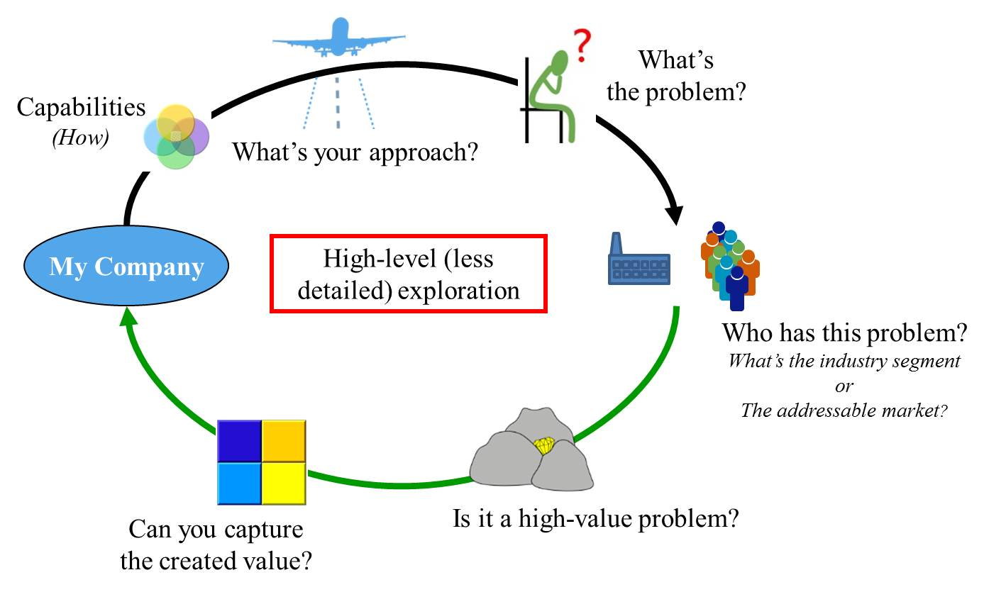
At the end of Opportunity Identification you know
Notes:
Zooming out from the qualitative description of the business produces a high-level (albeit less detailed) look. Zooming out widens the field of view while lessoning the amount of detail that can be observed. An approach to solving a problem is determined before a specific offering is detailed in the Business Design segment. The customer is not known in detail, but the industry segment or addressable market that has an identifiable problem is known a the end of this level.

Slide 13
Common Mistakes at this phase
Zoom in too soon on a specific customer
Odds less than 3000:1 of guessing right
Cannot tell if it is a high-value problem
Cannot tell if you can capture value
Focus shifts to product development versus business development
Get “stuck” in a specific industry
Especially true with high-tech startups
Three nested loops (see next slide); continue to zoom back out as necessary

Slide 14
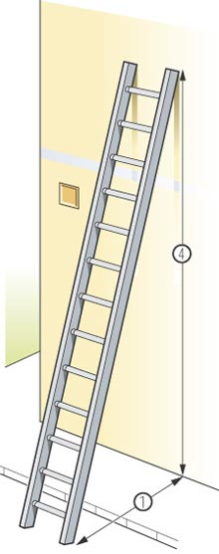
Putting a ladder against the wrong wall
If the ladder is not leaning against the right wall, every step we take just gets us to the wrong place faster.

Slide 15
Take a broad look
Fall in love with the problem, not with your initial solution
Means you need to uncover the real problem first!

Slide 16
Divergent and Convergent Thinking
DOC Process: Diverge-Organize-Converge
Divergent thinking
Expansion of ideas
Organize
Categorizing and connecting the divergent concepts
Convergent Thinking
Narrowing of ideas, focus

Slide 17
Find the Real problem, Then the Real solution
The “problem” and the “solution” must meet in the middle!

Slide 18
Creative and Analytical Thinking
Creative
Thinking of new approaches
Seeing things differently than most
Analytical
Assessing the problem
Assessing the solution

Slide 19
Broadening Ideas by Zooming Out, then In
Macro Issue: High-level opportunity
Energy Independence
Zoom-out
Brainstorm as Zoom-In
The Problem: Specific opportunity / issue
Need for renewable energy production
Zoom-out
Increase domestic supply of oil
Solution concept
Increase efficiency of solar cells
Brainstorm as Zoom-In
Extend deep-water drilling capabilities

Slide 20
Brainstorming while Zooming In
Potential Solution
Approaches
General Problem
Specific Issue
Macro Issue
… leads to more diverse ideas

Slide 21
Business Model Discovery via Levels
Who the business SERVES
Motive
Macro Driver
General Problem
Specific Issue
Need/Desire
Owner
Society
Industry
Industry segment
Customer
Monetize
Potential value creation
Create value
H. Value / Capture value
Revenue model
Margin Assessment
Investability Analysis
Owner
Society
Industry
Industry segment*
Customer
Act
Opening
Capabilities
Approach
Offering/Activities
Zooming In/Out
Directed Discovery Starting Point
Opportunity Identification
Business Design
* or Addressable Market

Slide 22
Vary Your approach: Five generic approaches to Value Creation:
New product entry
essentially a “me too” product/service to those that exist, but with some advantage
Substitute product (different solution for same need)
Better, faster, cheaper, more convenient than existing product/service
Can existing “product” be offered as a service?
Aggregation/Consolidation of a segment of the value chain
Collapsing multiple segments of the value chain
New Segment
Creating efficiencies between existing segments

Slide 23
Brainstorming while Zooming In
Potential Solution
Approaches
General Problem
Specific Issue
Macro Issue
… leads to more diverse ideas

Slide 24
Is this progress?
Now you have LOTS of ideas, not just one…
Need to screen those that are not viable…
This is the CONVERGENT thinking part
In Part II We will talk about how to do the
CONERGENT
Thinking Steps in Business Opportunity Identification

