Slide 1
ENT 205
Introduction to
Innovation and Entrepreneurship
Session 06:
What’s a Business?
Dr. Tim Faley
Kiril Sokoloff Distinguished Professor of Entrepreneurship
Special Assistant to the President for Entrepreneurial Initiatives
University of the Virgin Islands
Tfaley@UVI.edu

Slide 2
Let’s Start by examining the essence of a business

Slide 3
Exchanging Value for Value
A business solves a specific problem for a specific set of people in a repeatable way
It exchanges the value it delivers to the person with the problem (“customer”) for something that is of value to the business (usually money, but it could be a barter, or something else)
A business is financially sustainable system
Separates it from a “hobby”

Slide 4
Customers
If a business is a financially sustainable system that solves specific problems for specific people, then you need to be able to identify who those specific people are and what specific problems you are solving for them!

Slide 5
EVERYONE = NO ONE
Copyright © 2014 by Timothy L. Faley

Slide 6
10% of EVERYONE = 10% of NO ONE
Corollary….
Copyright © 2014 by Timothy L. Faley

Slide 7
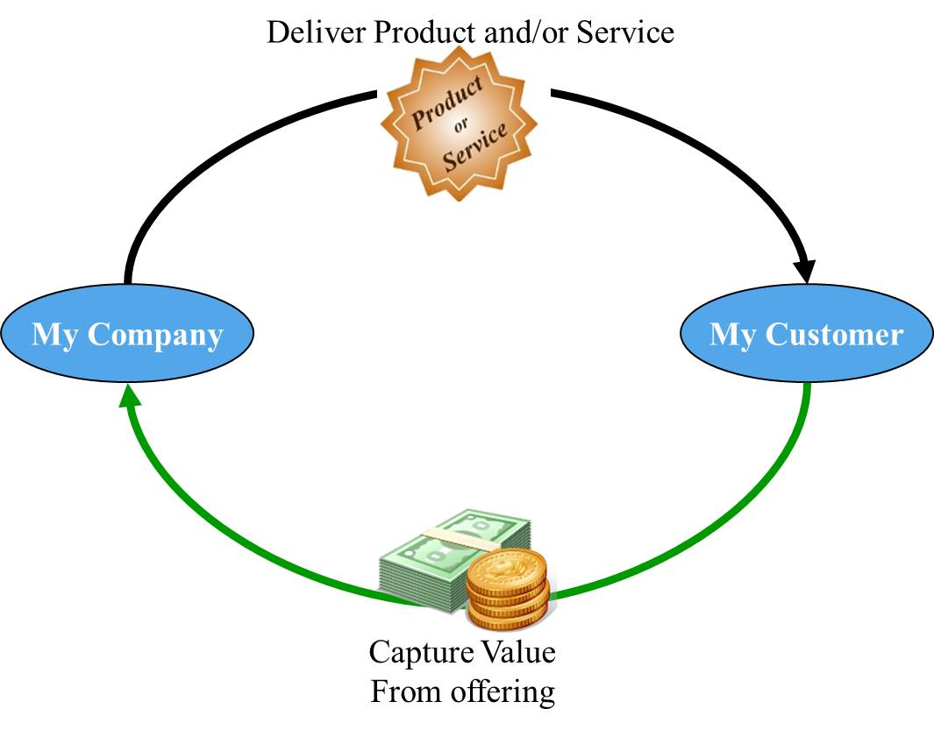
Typical Business
Notes:
Creating value is not enough; must capture enough of the created value to ensure the continuous operation of the enterprise

Slide 8
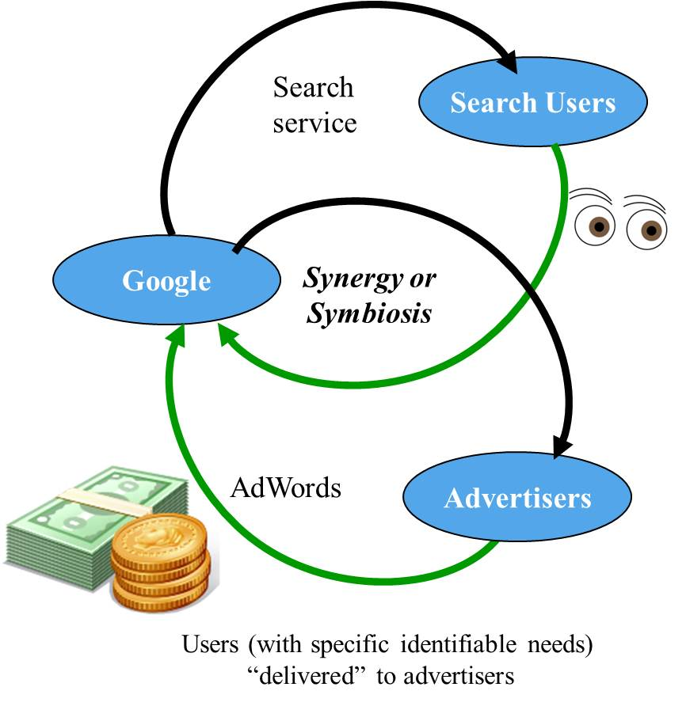
Multi-platform Business (ex. Google)

Slide 9
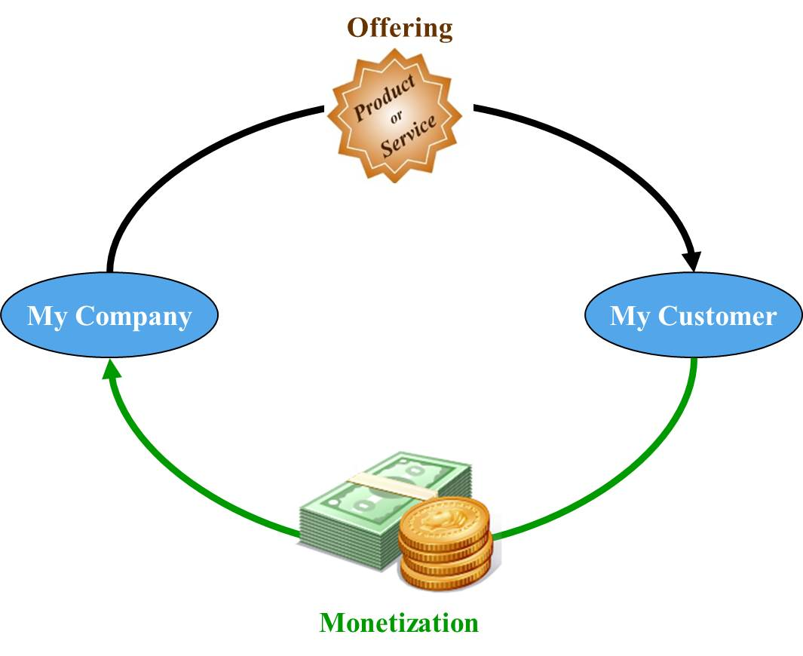
Focusing on a Simple Business (or the cash generating loop of a multi-platform business)
Value Capture Loss
To Suppliers
And other “Collaborators”
Value Capture Loss
Through Taxes

Slide 10
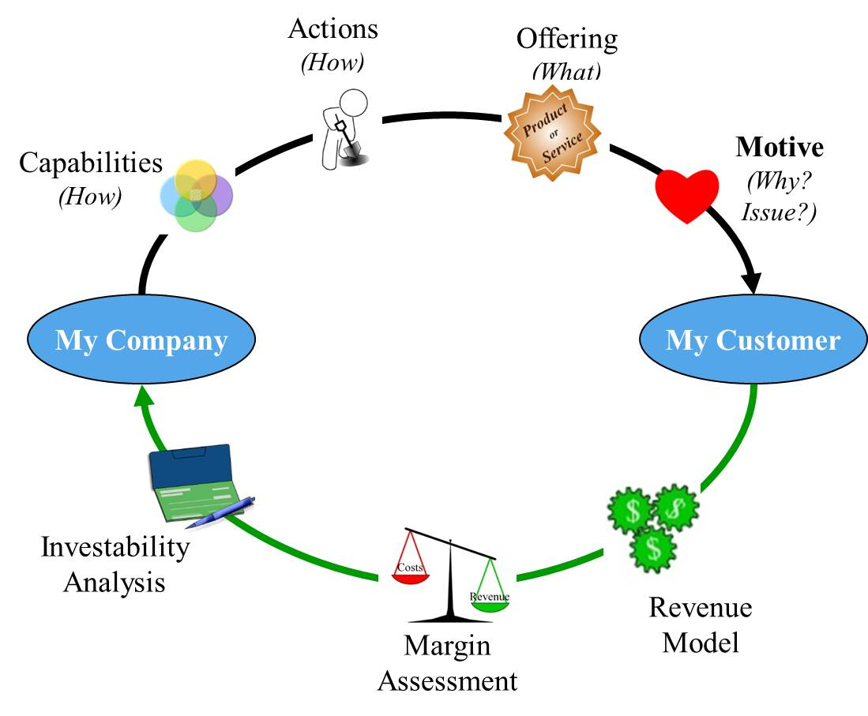
Zoom In slightly for a closer look
Notes:
The venture’s offering is created by the actions the company performs. These actions are based on the firm’s capabilities. The customer must have a reason to adopt the new offering. It must solve a an unmet or under-met need/desire. Finally the monetization has three components from three perspectives. The revenue model is takes into account the customer’s perspective. The margin assessment is an internal to the company look (cost to sell must be more than the cost to produce), finally the third perspective is from the venture’s investors.

Slide 11
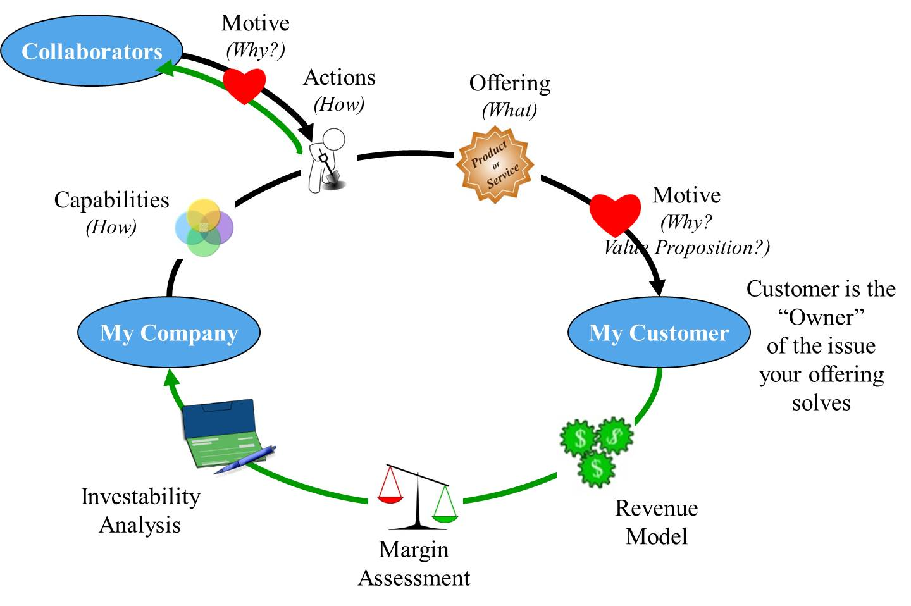
The Complete Business Model
Note: The new venture does not do everything itself in the creation and delivery of its offering to its customers. It leverages to existing business ecosystem.
Detailed
and Quantitative

Slide 12
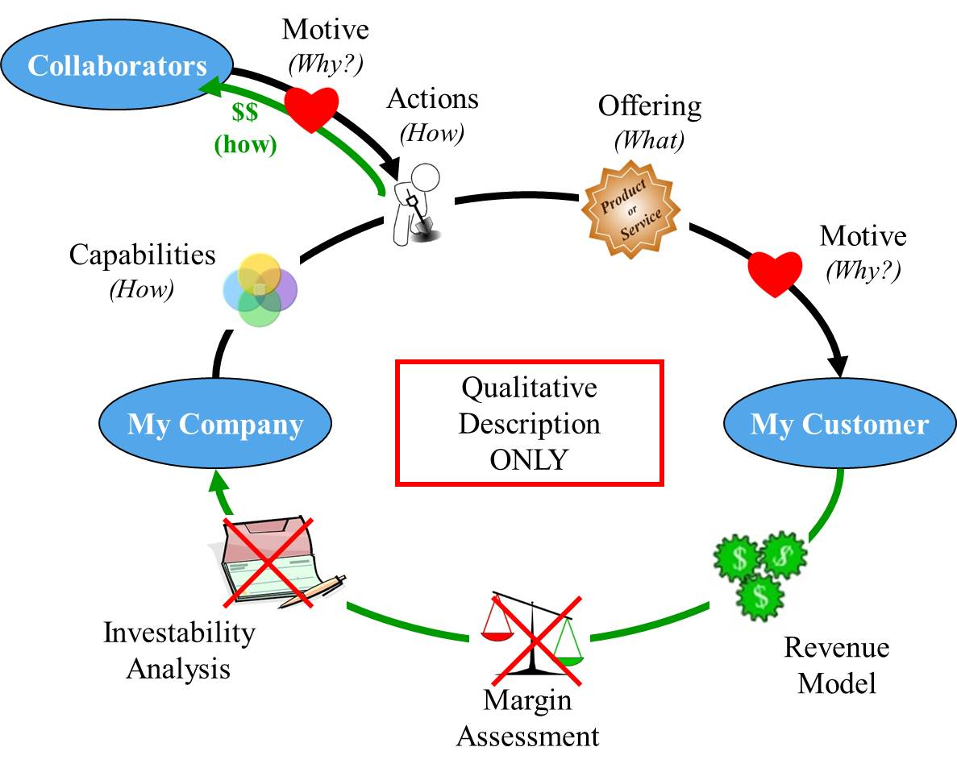
Zoom out to see only qualitative measures
Notes:
Simultaneously doing quantitative and qualitative discovery can be confusing and overwhelming for the inexperienced entrepreneur. By zooming out and first examining only the qualitative components allow you to be more creative and less constrained by the numbers.

Slide 13
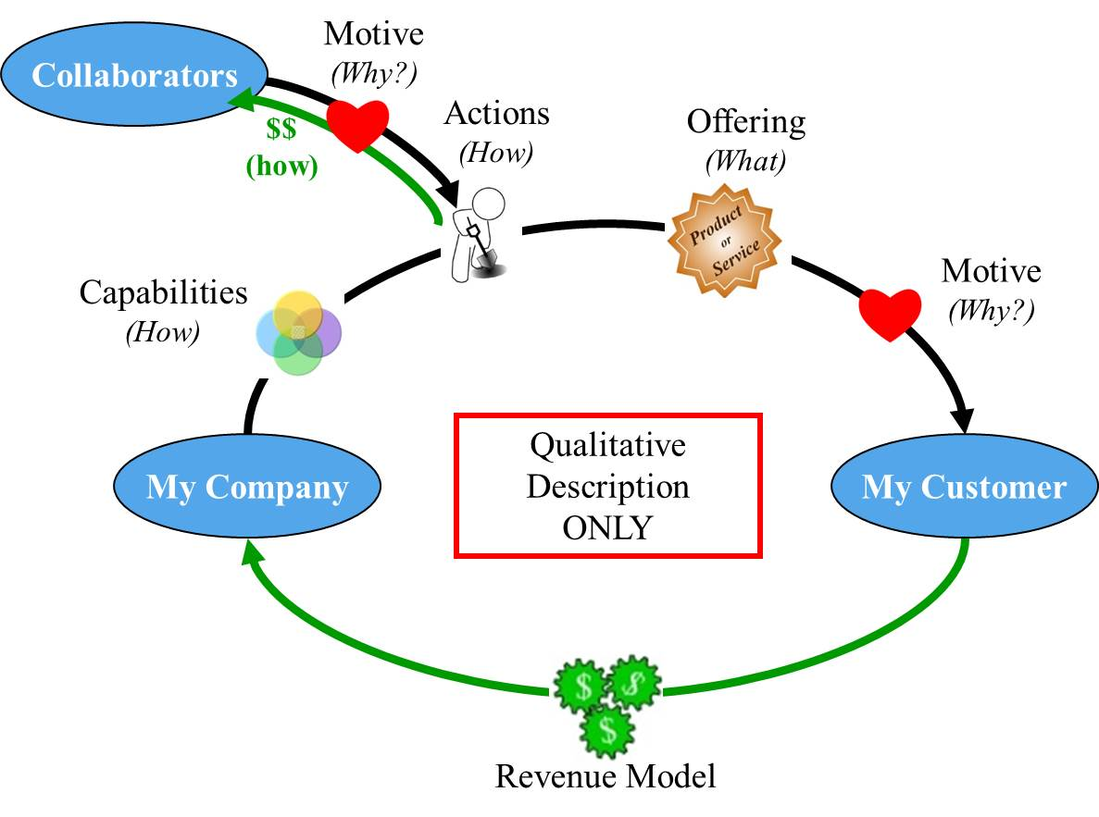
Qualitative Business Model Specific, complete, qualitative description
Notes:
This qualitative-only business description is not a complete business model. At the University of Michigan, we have call this qualitative-business model the “Business Construct.”

Slide 14
Business Development
Define the Qualitative Business Model
Qualitatively assess the business
Define the Quantitative Business Model
Quantitatively assess the business
Create a operational plan for the business

Slide 15
Questions?
What do you find confusing?
What questions do you have?
E-mail me.
Tfaley@uvi.edu
Make sure to put “ENT 205” in the subject line of the e-mail!

