Slide 1
ENT 205
Introduction to
Innovation and Entrepreneurship
Session 1:
Perspective & Point-of-View
Dr. Tim Faley
Kiril Sokoloff Distinguished Professor of Entrepreneurship
Special Assistant to the President for Entrepreneurial Initiatives
University of the Virgin Islands
Tfaley@UVI.edu

Slide 2
What you see ….
Depends how you look at it
Perspective
Mental or physical place from which you view the situation
Vantage Point
How Near or Far are you away from what you are looking at?
Includes a mindset or attitude
– is it a “problem” or an “opportunity”
Point-of-View (POV)
From who’s “eyes” do you see the situation
Do you see the business’ operations from a customer’s point-of-view, an employee’s point-of-view, or a business’s owner?

Slide 3
Not “wrong,” just “incomplete”
No Point-of-views or perspective is “wrong”
Each is simply incomplete
The more points-of-view and perspectives you can “see” from, the better your problem AND solution definition will be

Slide 4
Typical View of a can of Pepsi

Slide 5
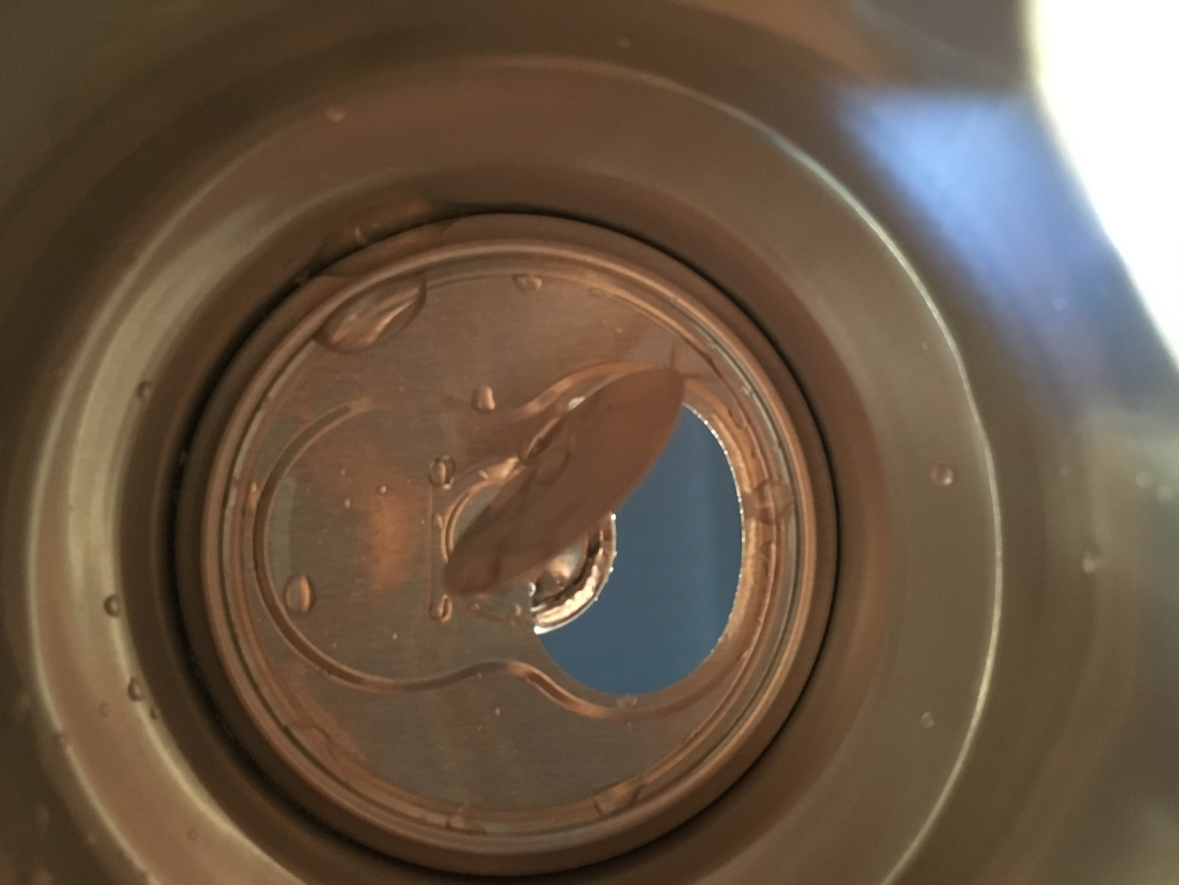
View from Inside the can

Slide 6
Perspective: Zooming in and out
Big Picture
Broad perspective (wide field of view)
Few details
Narrow perspective
Detailed examination (narrow field of view)
Many details, little perspective
Take on-line Quiz 0 (ungraded) on “Perspectives” now
Participate in on-line discussion regarding quiz

Slide 7
Your Perception can be part of the problem
Be aware of your heuristics (beliefs of how things work)
Be aware of the heuristics of others
Look at the problem at different scales, from different points-of-view

Slide 8
Changing Perspective: Zooming In and Out
The World
The Forest
Zooming In/Out
The Tree
The Leaf

Slide 9
Zooming in and out
Big Picture
Broad perspective (wide field of view)
Few details
Narrow perspective
Detailed examination (narrow field of view)
Many details, little perspective
http://www.ispot.tv/ad/7b6H/deutsche-bank-perspective

Slide 10
Changing your Perspective
Be aware of your heuristics
Be aware of the heuristics of others
Look at the problem at different scales
Use tools to see things others cannot

Slide 11
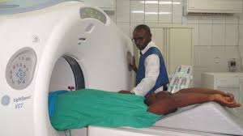
Frameworks: Business tools for seeing what others do not

Slide 12
Course will introduce you to new tools
Showing (and telling you about) you new tools has VERY limited value
What’s this?

Slide 13
Must USE the tools of this course
There are lots of tools out there…
The ones of this course may not always be the BEST for every problem. But…
The purpose is to EXPAND your toolset
You must practice USING the tools in order for them to become part of your toolset
…
Your assignments and FINAL project will be graded on how well you incorporate the tools introduced in this course into your paper. If you write a paper that you could have written BEFORE you took this course, that will be a “D” (because you gave me no evidence that you learned ANYthing from this course!) I am interested in you LEARNING.

Slide 14
Questions?
What do you find confusing?
What questions do you have?
E-mail me.
Tfaley@uvi.edu
Be sure to put “ENT 205” in the e-mail subject line!

